Slide 1
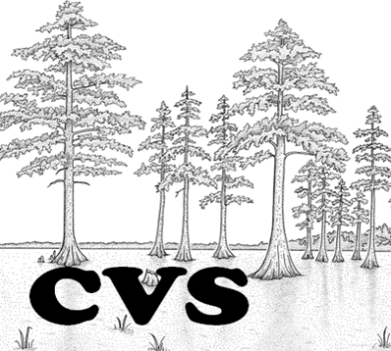
CAROLINA VEGETATION SURVEY
25+ years: 1988 – 2012+

Slide 2
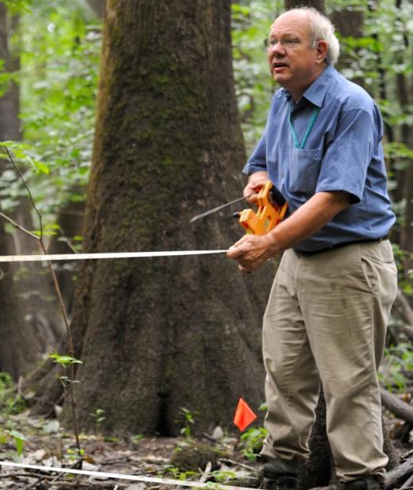

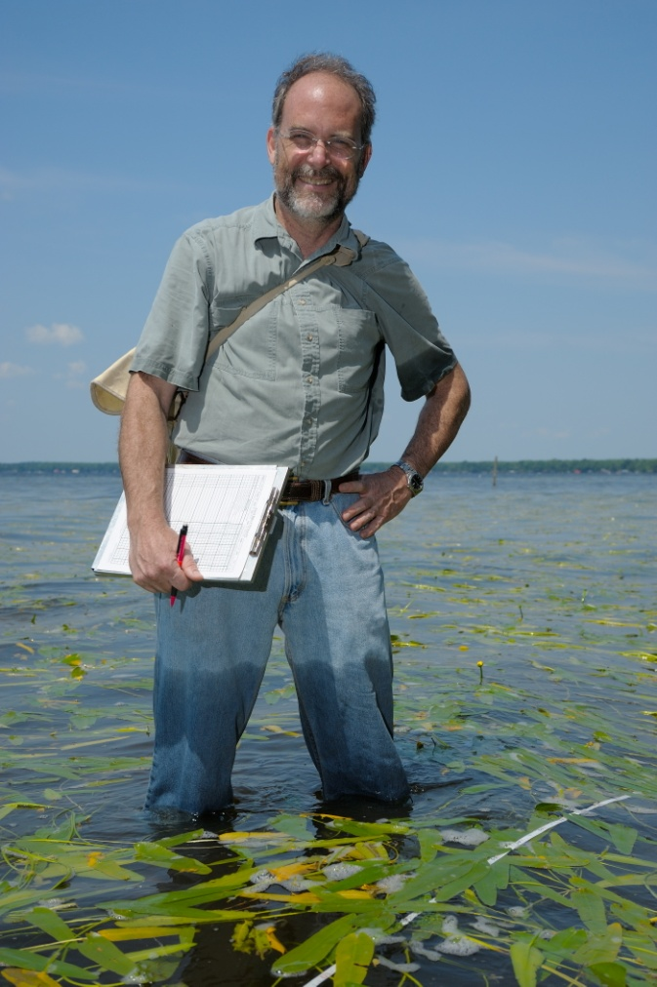

Collaborators
Robert Peet
University of NC
Mike Schafale Alan Weakley Tom Wentworth
NC Natural Heritage NC Botanical Garden NC State University

Slide 3
Roadmap
What is CVS
CVS Protocol
Pulse
Community classification & description
Applications & Results

Slide 4
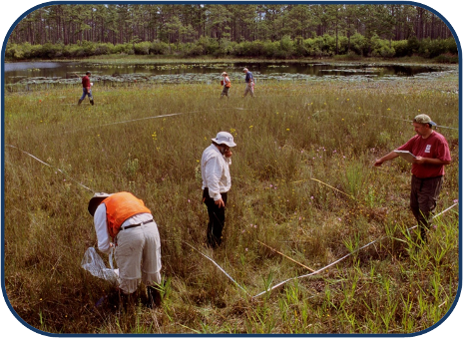
The Carolina Vegetation Survey
Multi-institutional collaborative program
Established in 1988 to document the composition and status of natural vegetation of the Carolinas.
We provide data
services & analysis
to: US-NVC (FGDC),
NCDENR (EEP,NHP),
USDA-NRCS.

Slide 5
Why CVS?
Description, classification, and analysis of the natural vegetation of the Carolinas,
Determine attributes of individual taxa,
Inventory of communities & species,
Long-term monitoring – both natural and modified lands,
Targets for restoration,
It’s fun !

Slide 6
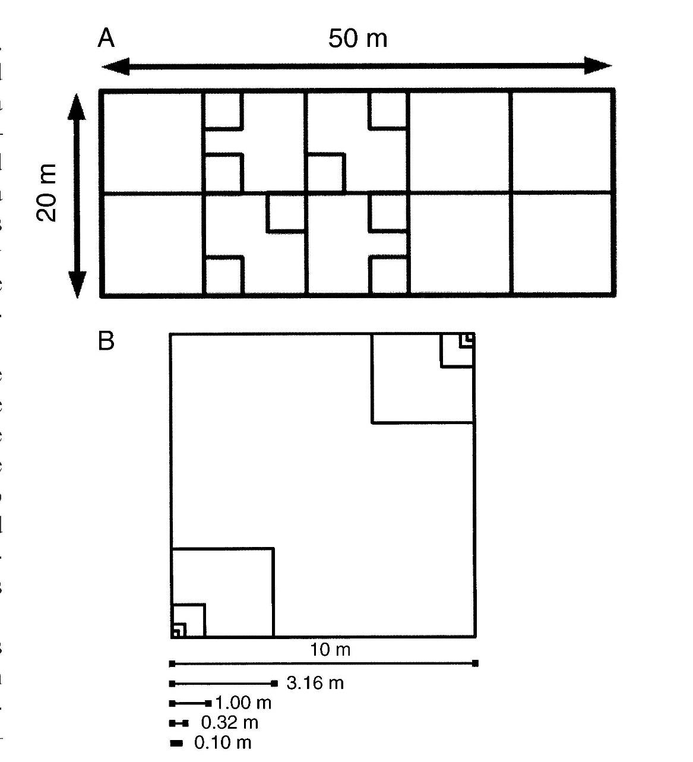
The CVS protocol
Flexible in application
Multi-scale data
Most cited paper
in Castanea (226).
Basis for new national protocols for EPA and NEON.
Informed the FGDC
& ESA standards for vegetation sampling and classification
(Ecol. Monogr. 2009)

Slide 7
The Pulse Approach
Based on community collaboration
Provides training & experience
Intense regional focus for one week
    “Bootcamp for botanists”
    “Botanical Woodstock”
    “Extreme botany”
Sign up! – http://cvs.bio.unc.edu
    2013 –Central & western Piedmont

Slide 8
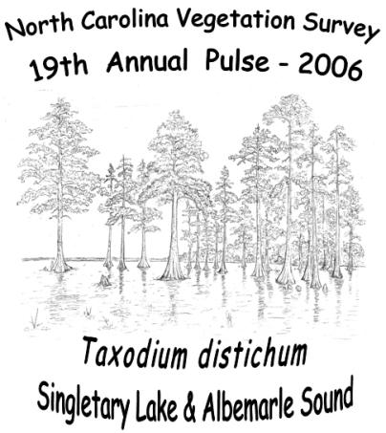
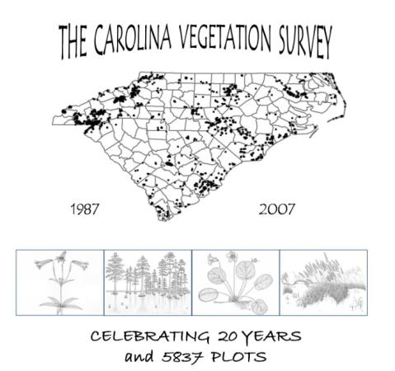
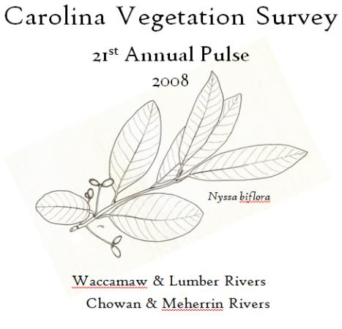
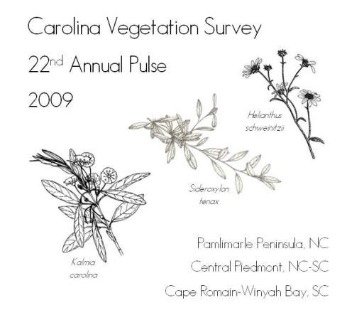
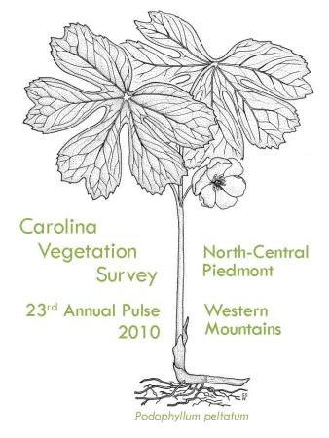
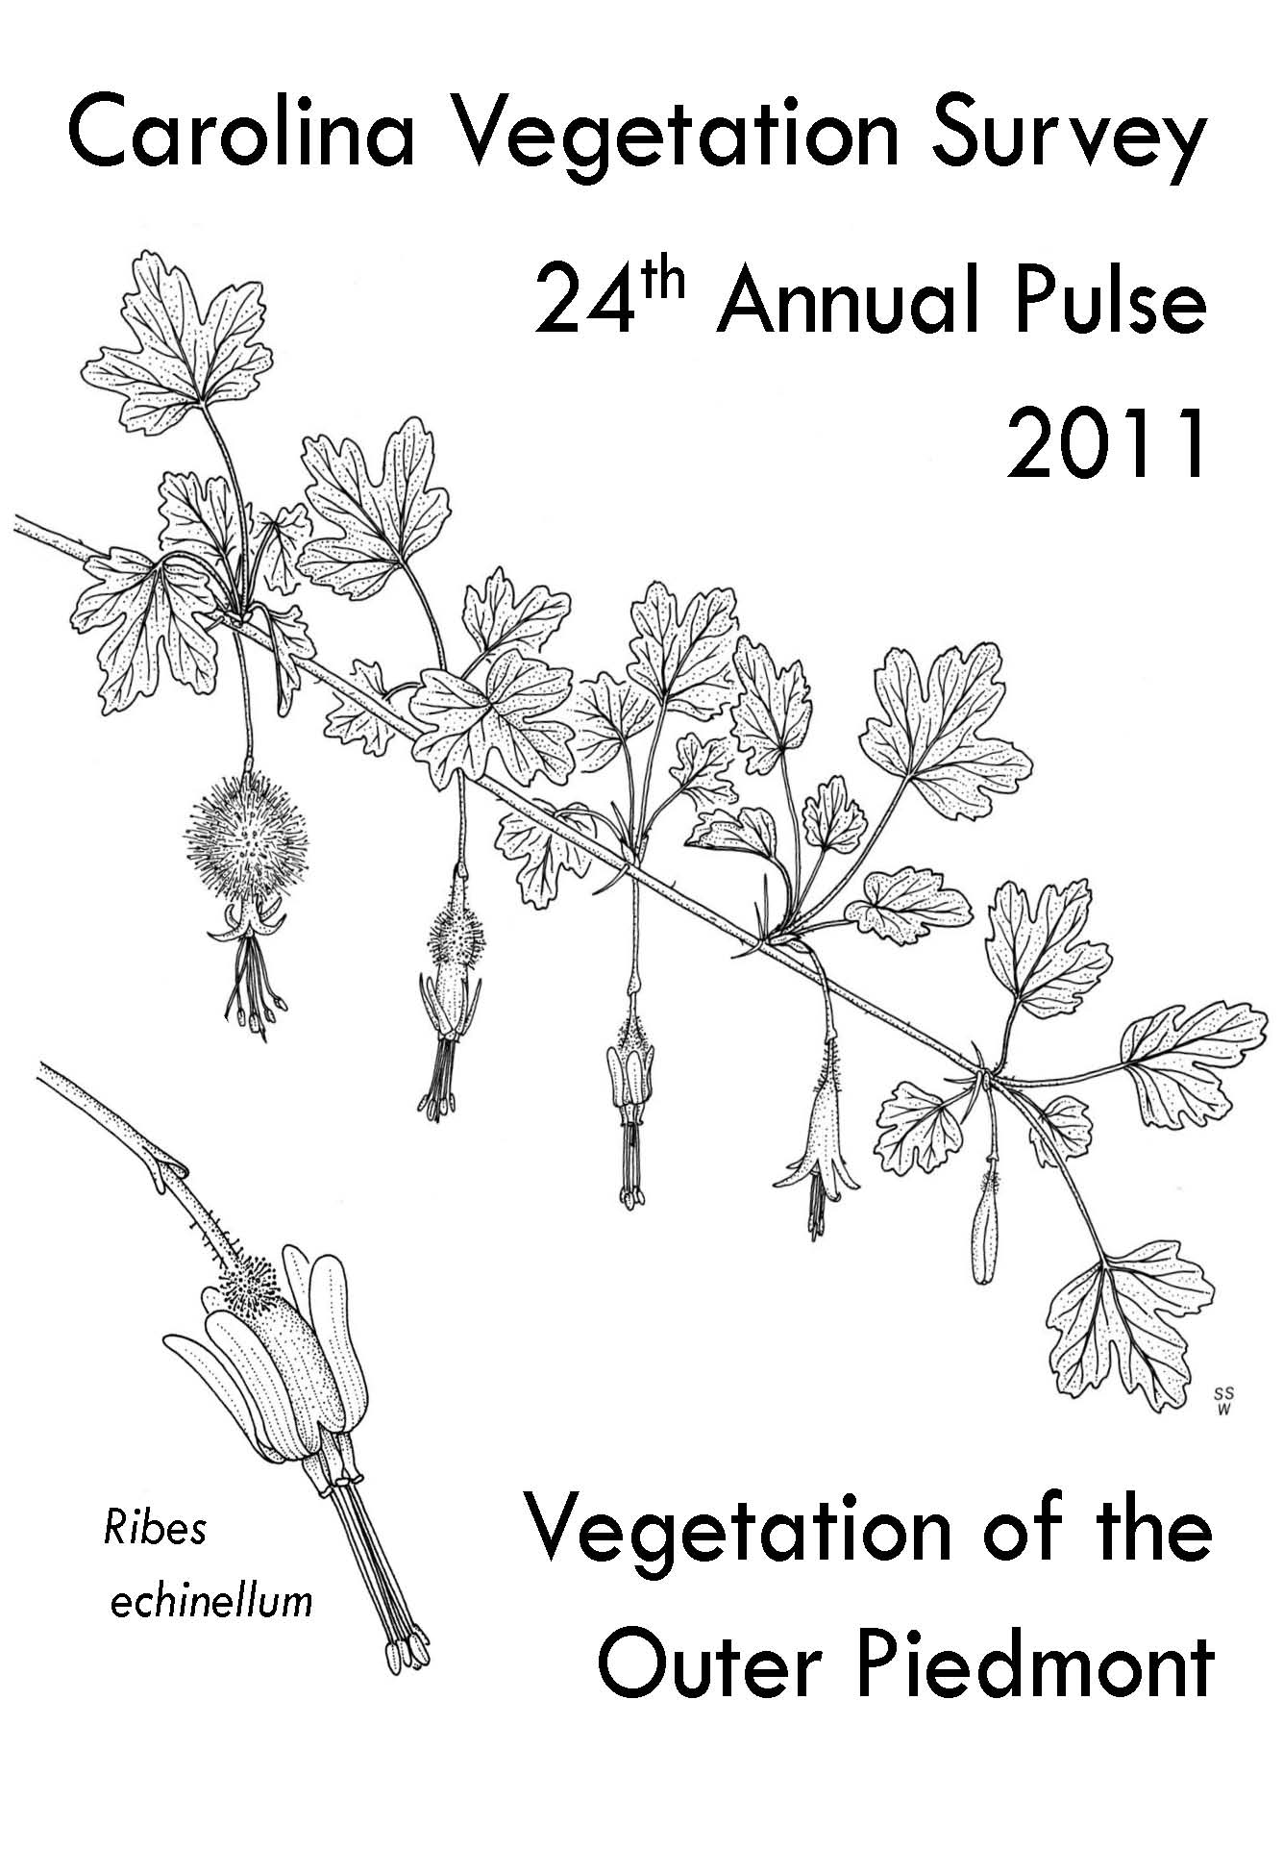
PULSE T-SHIRTS

Slide 9
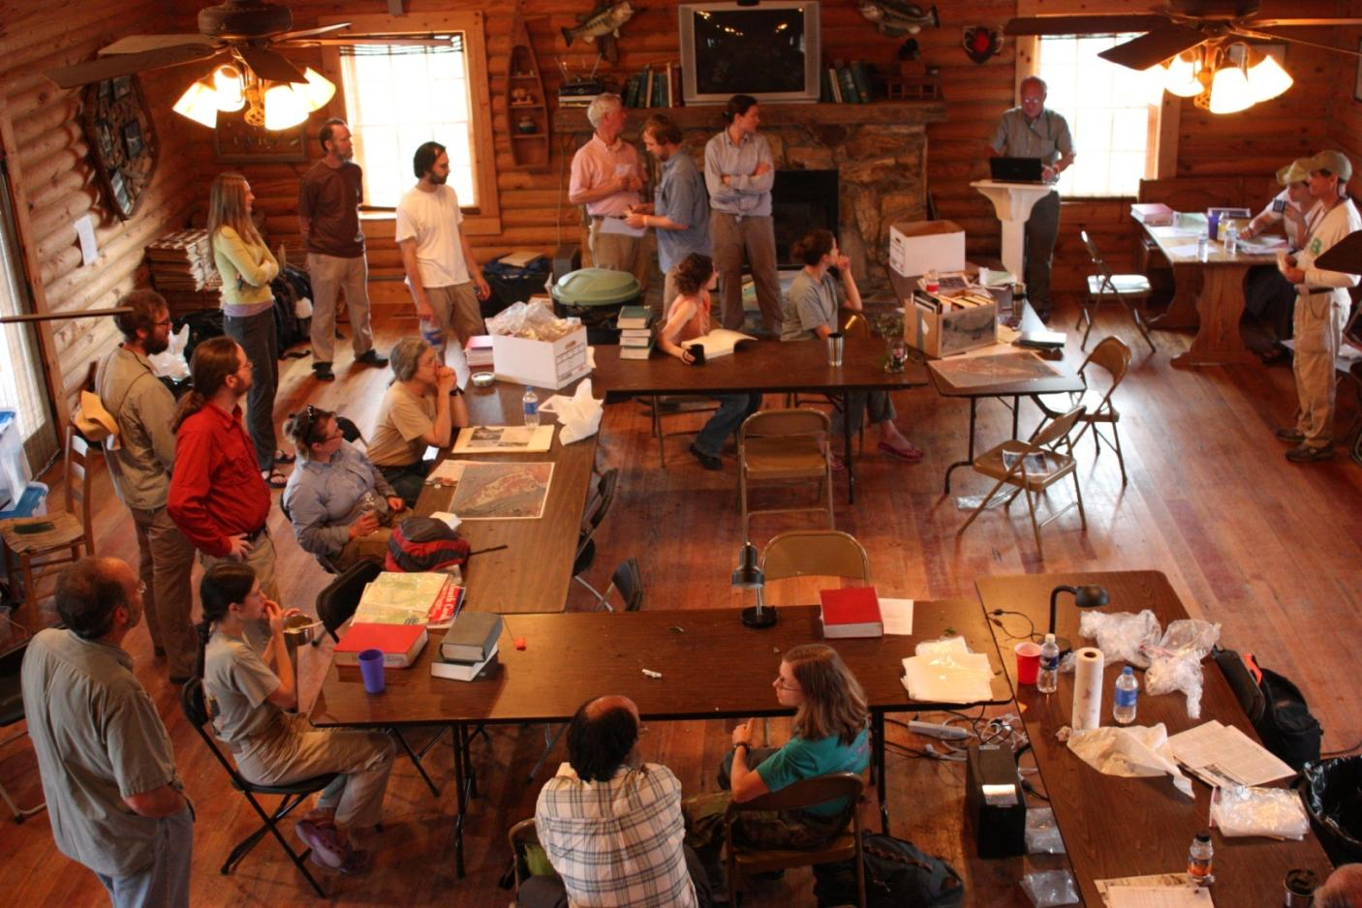
The day starts with the reading of the teams

Slide 10
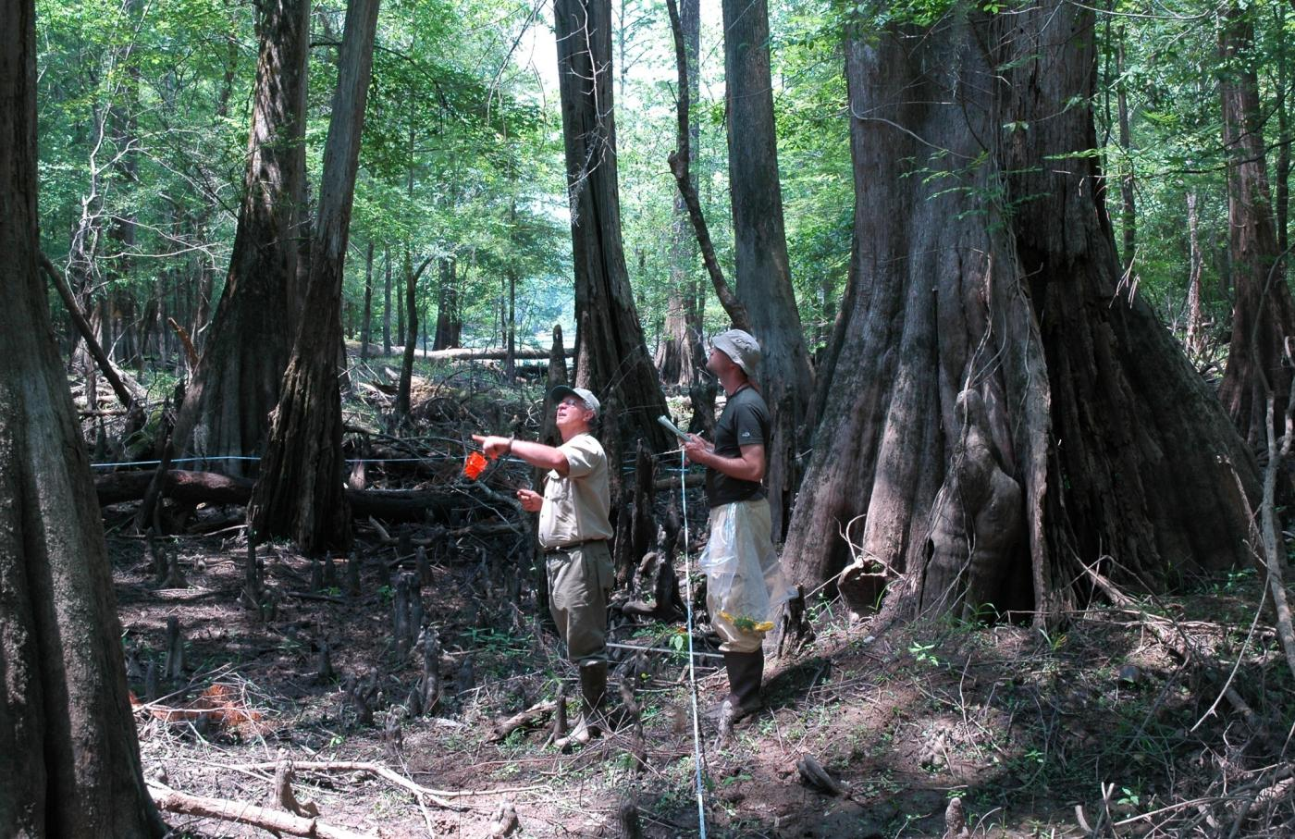
Once a plot is set up, the fun begins!
Photo by D. Blevins

Slide 11
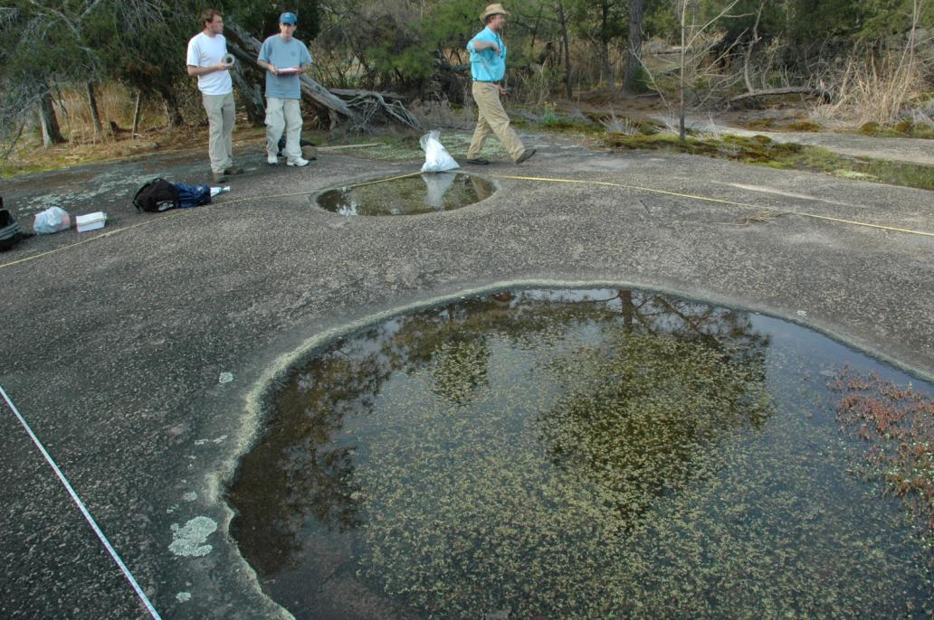
Fall line rock outcrop vegetation Amphianthus pusillus & Diamorpha smallii Forty Acre Rock HP, Lancaster Co, SC

Slide 12
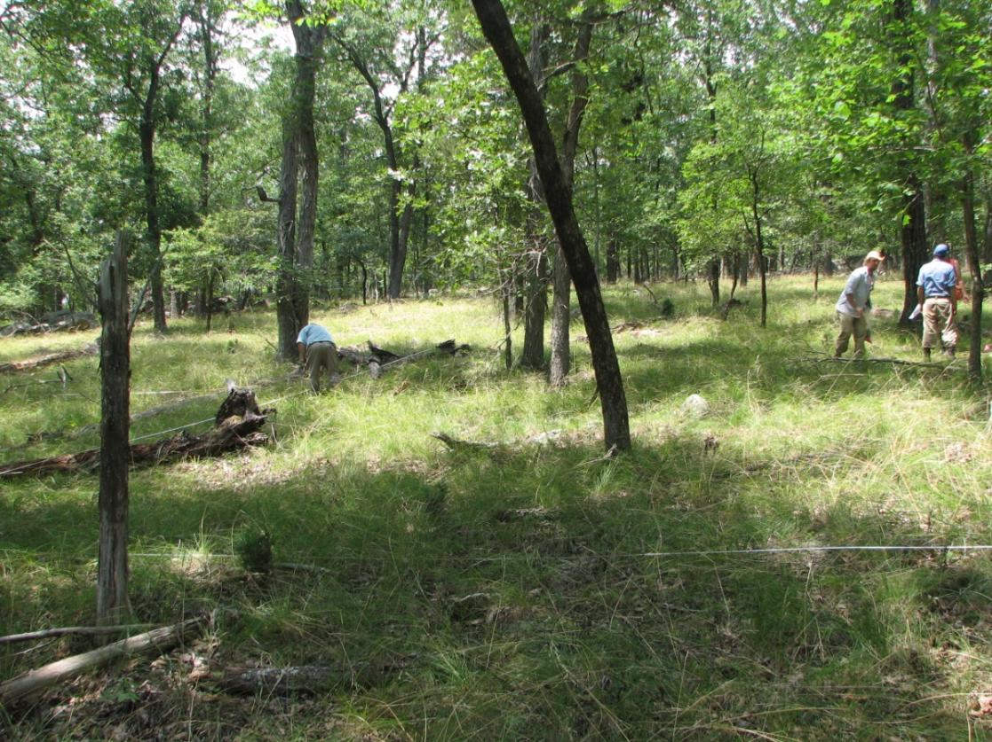
Xeric, mafic glade forest
Morrow Mountain SP, Stanly Co, NC

Slide 13
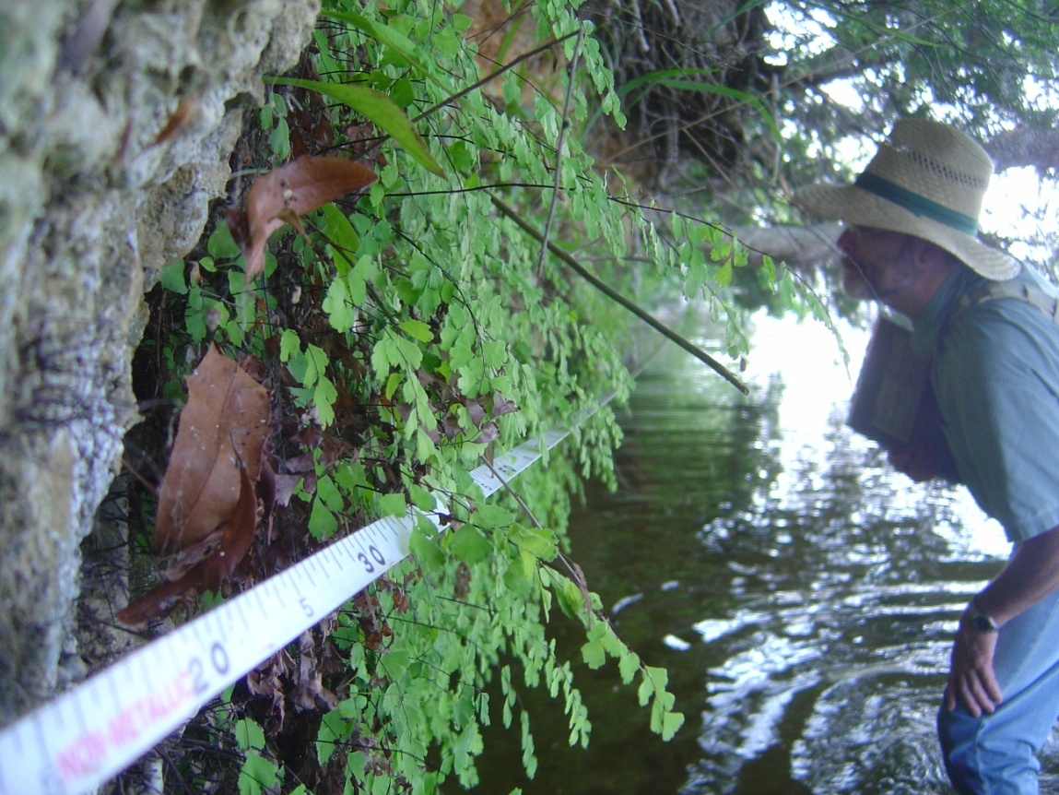
Marl outcrop – Lake Waccamaw, Columbus Co, NC

Slide 14
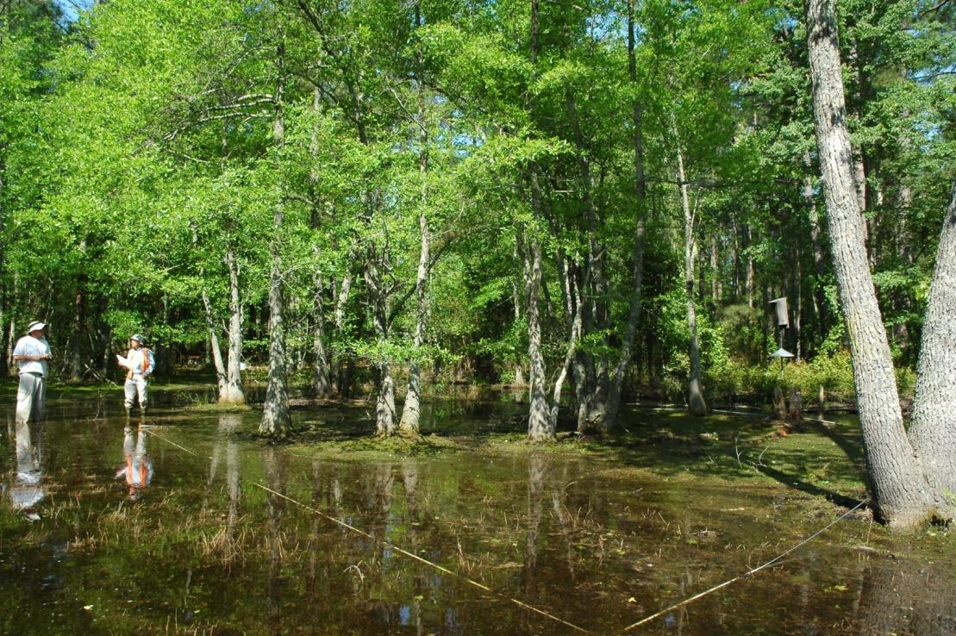
Sandhills depressional wetland forest Sandhills GL, Richmond Co, NC

Slide 15
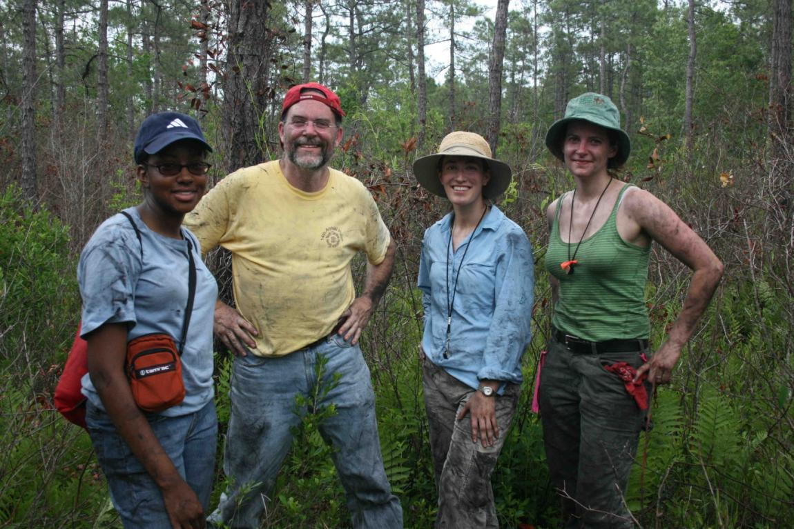
It can be difficult to stay clean.
Old Dock savanna, Columbus Co, NC

Slide 16
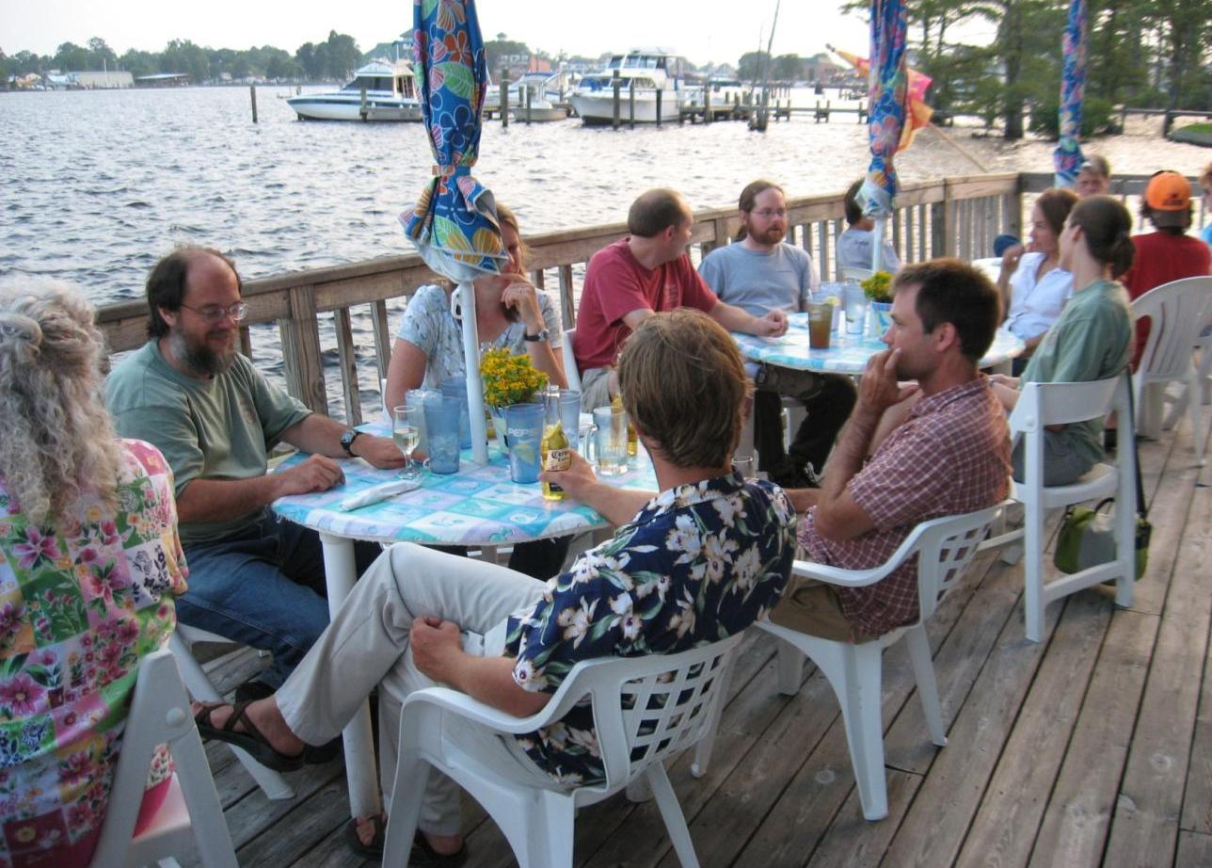
Good food and a nice view are nice for a pulse dinner. But the real key is ample seating

Slide 17
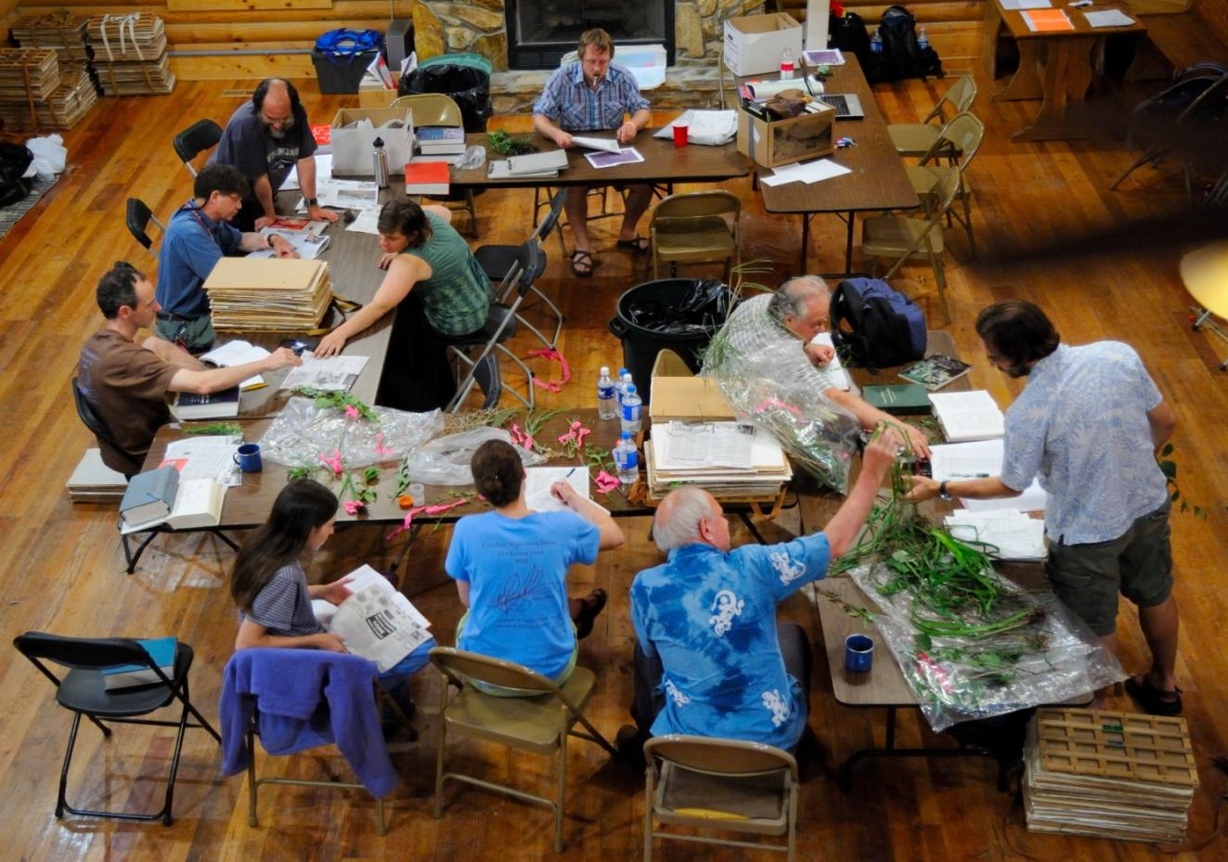
The day concludes with a plant id party!!

Slide 18
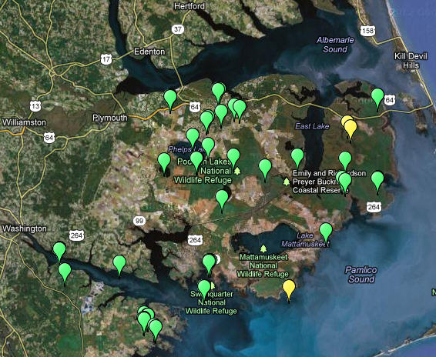
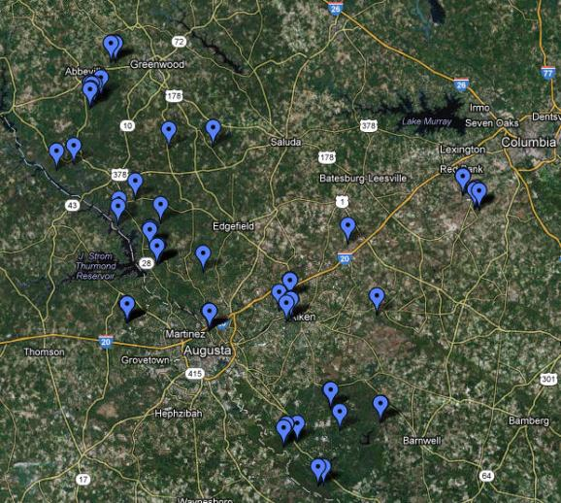
Destinations for: PULSE 2006 – 2012
2006A – Singletary Lake, NC
2006B – Elizabeth City, NC
2007A – Western sandhills, NC
2007B – ACE Basin, SC
2007C – Croatan & Downeast, NC
2008A – Waccamaw & Lumber Rivers, NC/SC
2008B – North-eastern tier, NC
2009A – Albemarle Peninsula, NC
2009B – South-central Piedmont, NC
2009C – Maritime fringe, SC
2010A – North-central Piedmont, NC
2010B – ‘West of Detroit’, NC
2011A – Southern Piedmont, SC
2011B – Triangle & vicinity, NC
2012A – Central Coastal Plain, NC
2012B – Central Piedmont, SC

Slide 19
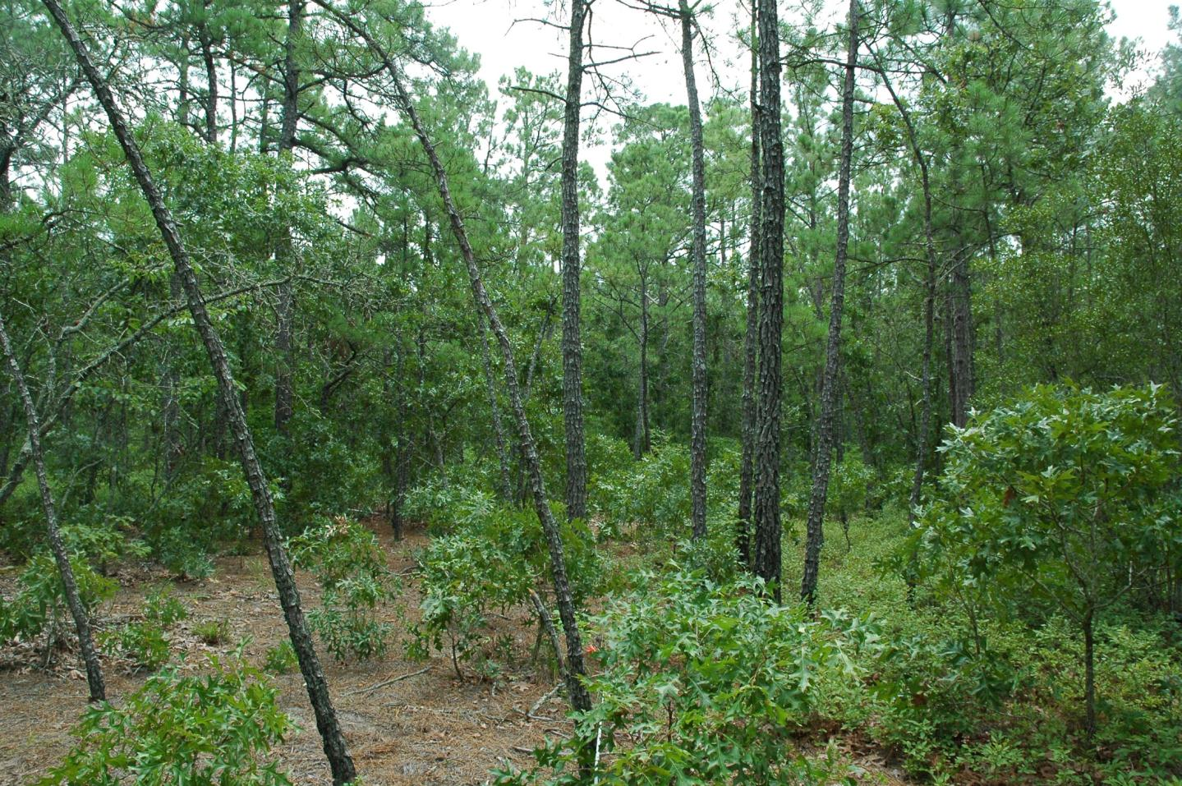
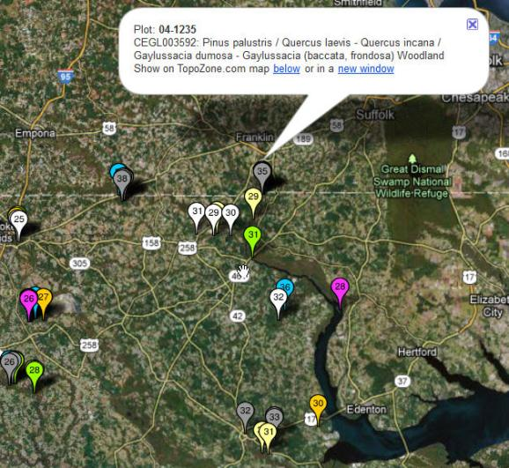
Wyanoke Sand Ridge
Gates County, NC (Plot 89-4-1235)
5 species of Pine!

Slide 20
Example of the NVC
Hierarchy | Example
Upper
Level 1 – Formation Class | Forest & Woodland
Level 2 – Formation Subclass | Temperate Forest
Level 3 - Formation | Warm Temperate Forest
Middle
Level 4 – Division | Southeastern North Amer. Warm Temperate Forest
Level 5 – Macrogroup | Longleaf Pine & Sand Pine Woodland
Level 6 – Group | Xeric longleaf Pine Barrens Group
Lower
Level 7 – Alliance | (? Under revision)
Level 8 – Association | Longleaf Pine / Scrub Oak Sandhill (Northern Type)

Slide 21
CVS Vision
Revision & documentation of the
National Vegetation Classification (NVC)
to better serve Carolina users
Public Carolina vegetation plot database
Reference information on all vegetation
types of the Carolinas
Publication of a synthesis of Carolina vegetation
Tools for identification and prediction of potential natural vegetation
Tools to aid restoration of natural vegetation

Slide 22
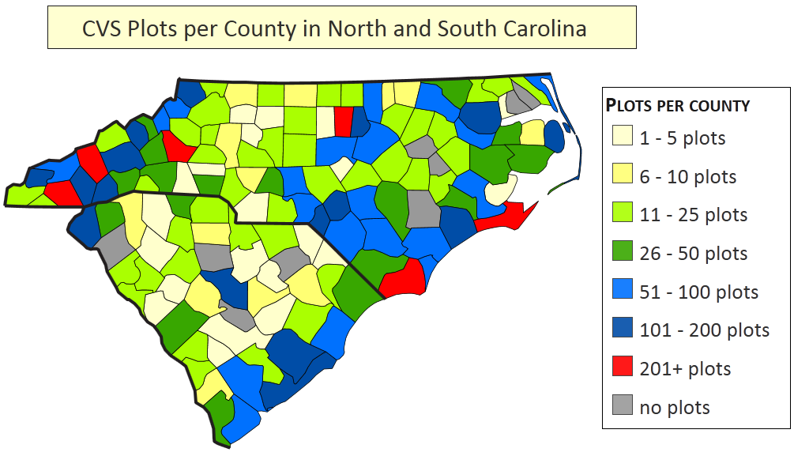
CVS report card for NC & SC
>9330 High-quality reference plots
302 Carolina community types with >= 4 plots
517 Carolina community types with >= 1 plot
~ 3092 Carolina species
~ 1001 participants

Slide 23
Species frequencies – NC & SC
3092 of ~4286 species; 273,072 occurrences
Octave | Frequency Range | Count
0 | 0 | ~1194
1 | 1 | 466
2 | 2-3 | 401
3 | 4-7 | 397
4 | 8-15 | 373
5 | 16-31 | 368
6 | 32-63 | 329
7 | 64-127 | 290
8 | 128-255 | 237
9 | 256-511 | 125
10 | 512-1023 | 76
11 | 1024-2047 | 25
12 | >2047 | 5

Slide 24
Most frequent species in NC & SC
Vines? Sparse trees?
4011 Acer rubrum (Red Maple)
2524 Smilax rotundifolia (Common Greenbrier)
2362 Smilax glauca (Whiteleaf Greenbrier)
2187 Toxicodendron radicans (Poison ivy)
2074 Parthenocissus quinquefolia (Virginia creeper)
1958 Nyssa sylvatica (Black Gum)
1877 Liquidambar styraciflua (Sweet gum)
1842 Vitis rotundifolia (Muscadine grape)
1769 Quercus rubra (Red Oak)
1648 Liriodendron tulipifera (Tulip poplar)
1516 Prunus serotina (Black cherry)

Slide 25
Who is missing?
Weeds of fields and waste places !
Rare species ?
Plants of special habitats ?

Slide 26
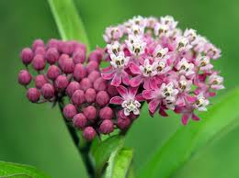
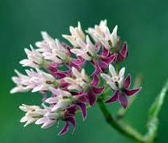
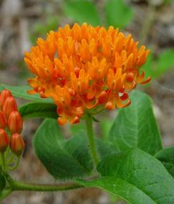
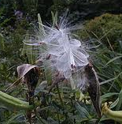
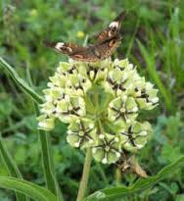
Occurrences of
Carolina Milkweeds
**=rare, *=uncommon (Weakley 2006)
35 |  | Asclepias amplexicaulis | 34 | ** | Asclepias perennis
0 | ** | Asclepias cinerea | 0 | ** | Asclepias purpurascens
1 | ** | Asclepias connivens | 32 |  | Asclepias quadrifolia
94 |  | Asclepias exaltata | 4 | * | Asclepias rubra
21 |  | Asclepias humistrata | 1 |  | Asclepias syriaca !
13 |  | Asclepias incarnata | 7 | * | Asclepias tomentosa
19 | * | Asclepias lanceolata | 40 |  | Asclepias tuberosa
34 | * | Asclepias longifolia | 35 |  | Asclepias variegata
8 | * | Asclepias michauxii | 28 | * | Asclepias verticillata
1 | ** | Asclepias obovata | 5 | * | Asclepias viridiflora
13 | ** | Asclepias pedicellata | 1 | ** | Asclepias viridis

Slide 27
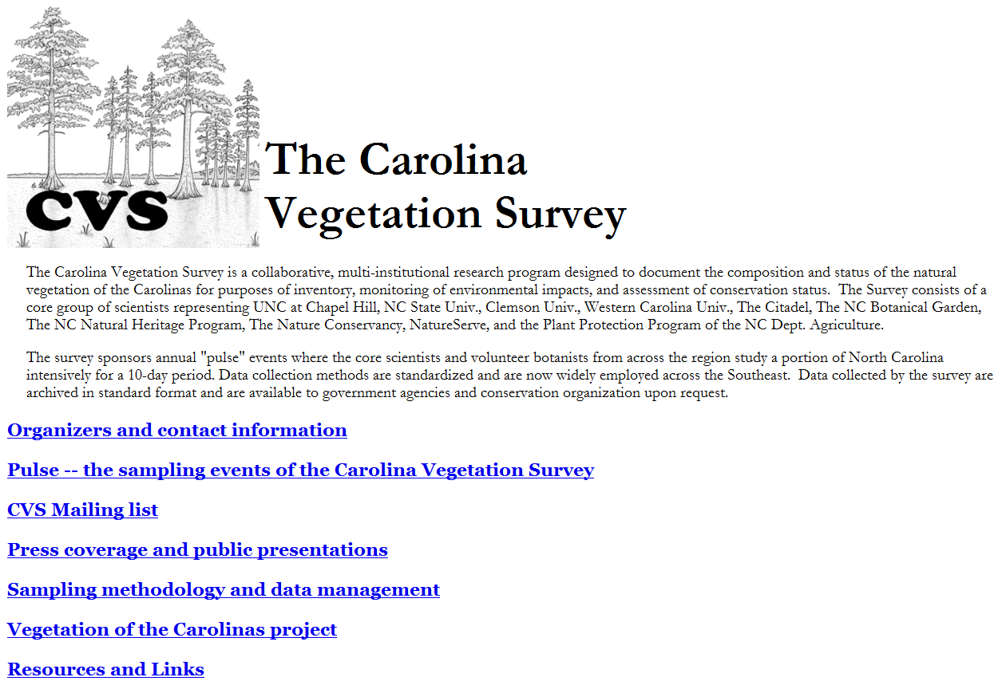
http://cvs.bio.unc.edu

Slide 28
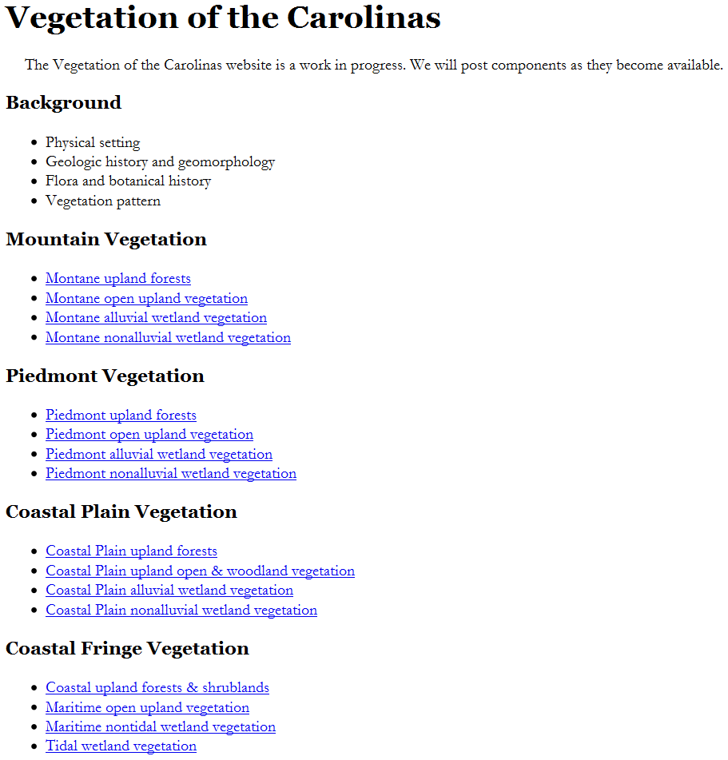
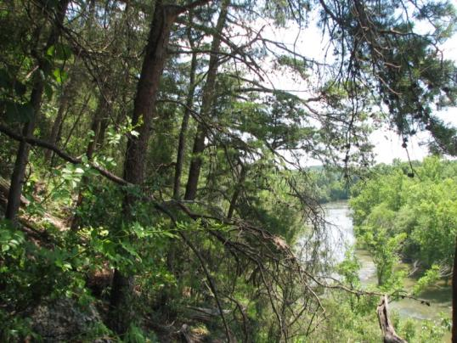
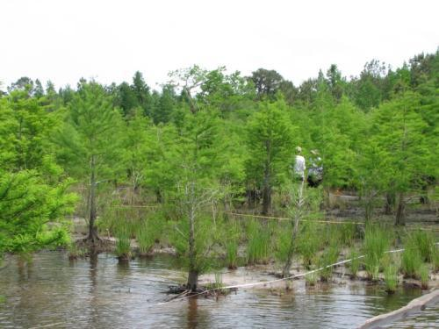
Physiognomic Group
http://cvs.bio.unc.edu/vegetation.htm

Slide 29
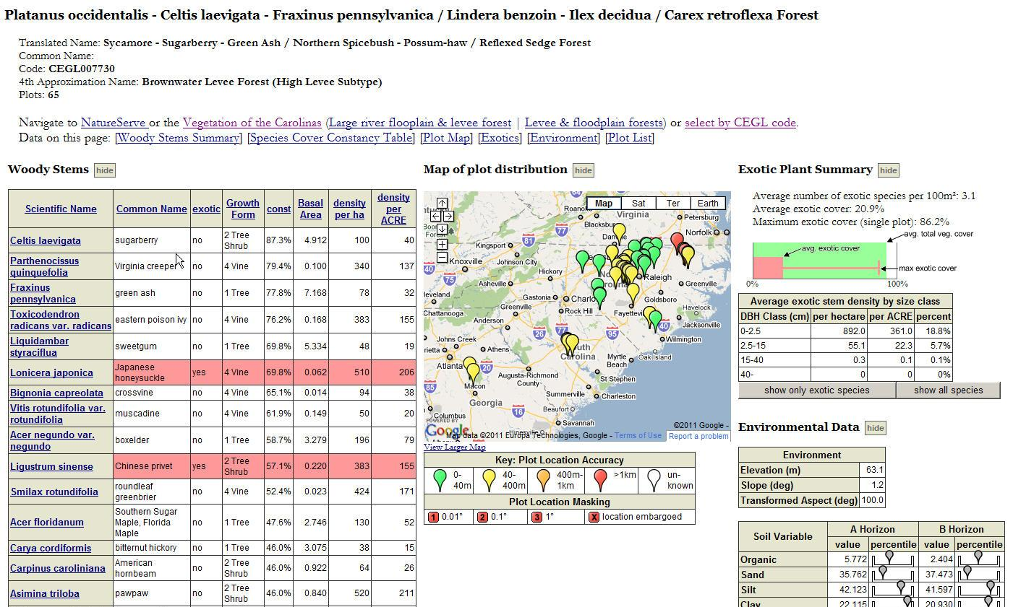
Comprehensive documentation of 517 Carolina community types
http://cvs.bio.unc.edu/data/comm/CEGL007730.xml

Slide 30
Opportunities & Applications
  Documentation & Inventory. What do we have?
  Restoration. What should be our restoration targets?
  Monitoring. What changes are really taking
  place in the vegetation?
  Remote sensing. What is really on the ground?
  Theoretical community ecology. Which taxa occur together – where & why?
  Modeling. Where should we expect species & communities to occur after environmental changes?

Slide 31

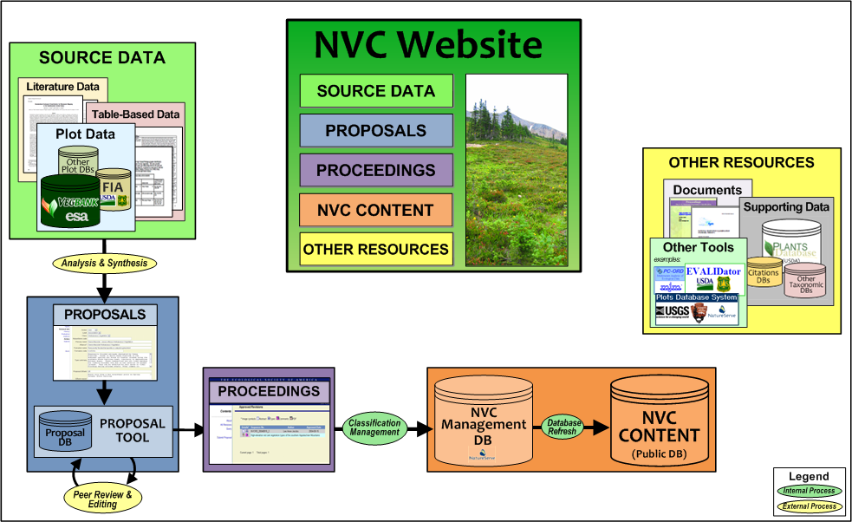
Looking to CVS for a Demonstration of the NVC

Slide 32
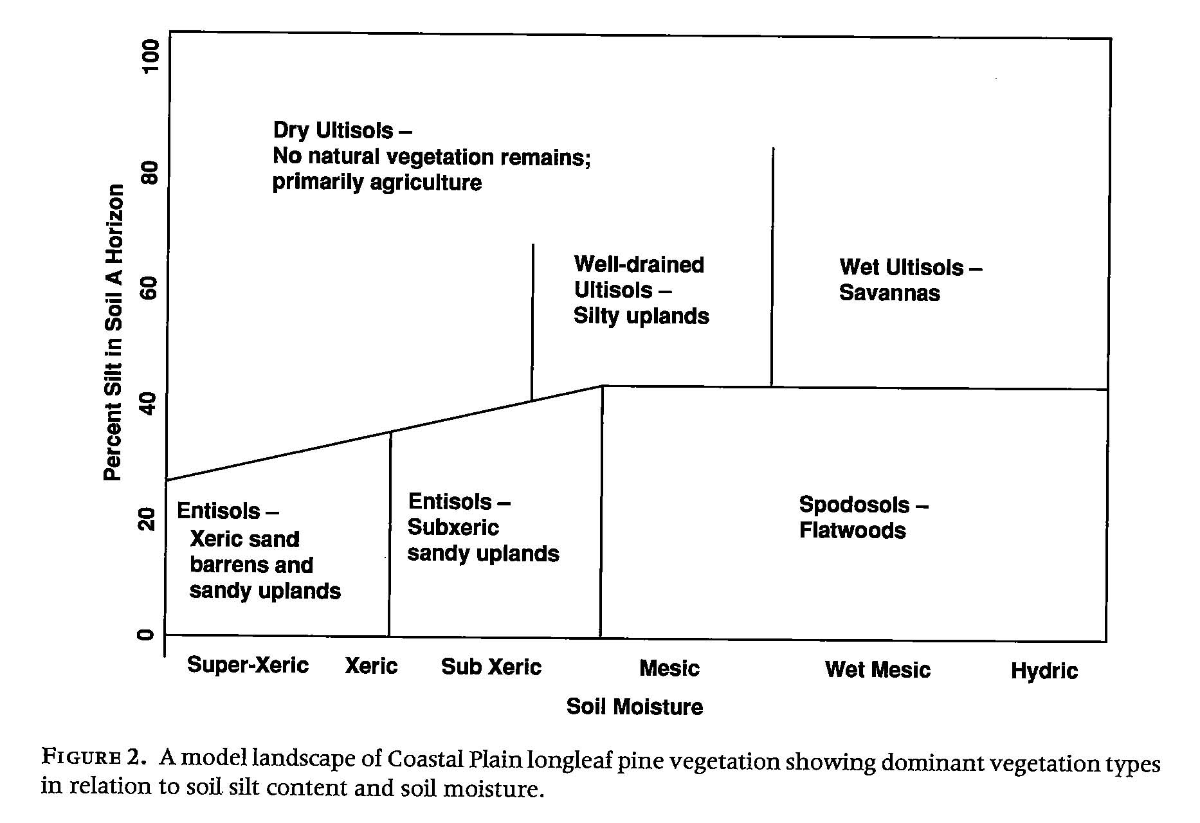
Longleaf Pine vegetation

Slide 33
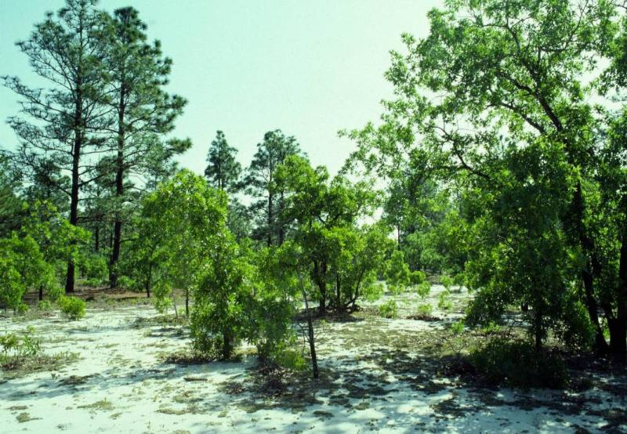
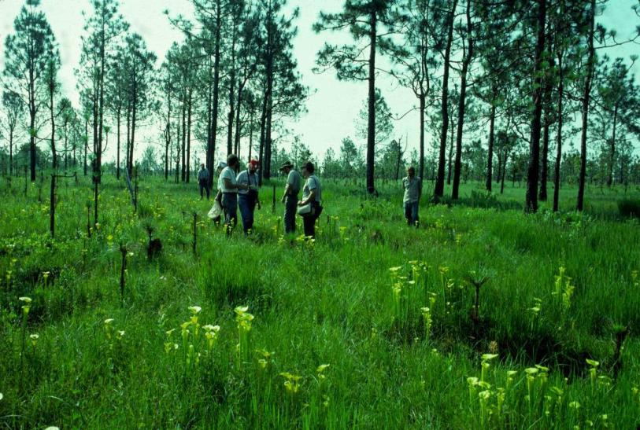
Xeric barrens & Subxeric uplands:
Longleaf – turkey oak woodlands on entisols
22 types
Savannas and seeps:
Longleaf woodlands on moist alfisols
13 types

Slide 34
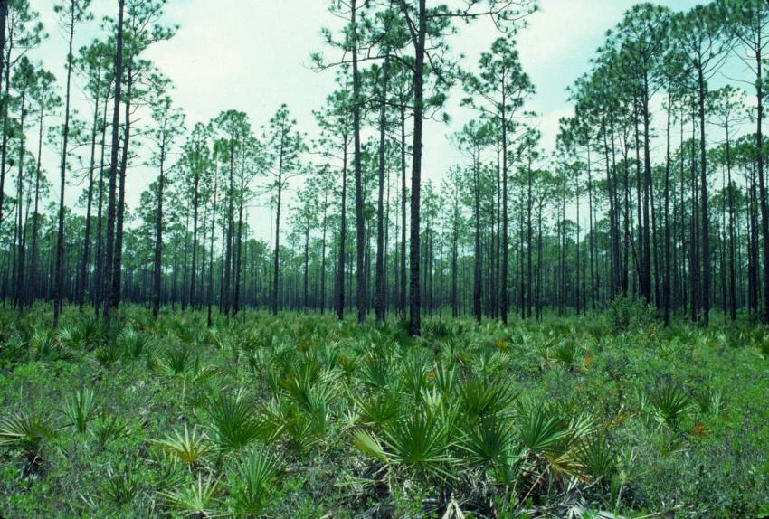
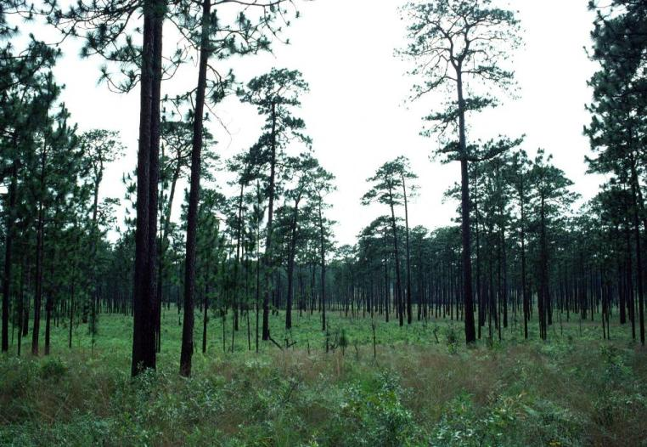
Flatwoods:
Longleaf woodlands of spodosols
5 types
Silty uplands:
Longleaf woodlands on well-drained ultisols
12 types

Slide 35
Longleaf pine woodlands
Comprehensive sampling initiative for Carolinas
54 types currently recognized in NVS,
perhaps 25% deriving from our work
We recognized 57 types,
of which 28 will remain unchanged.
We propose significant revision of 11 types
17 of our types are new

Slide 36
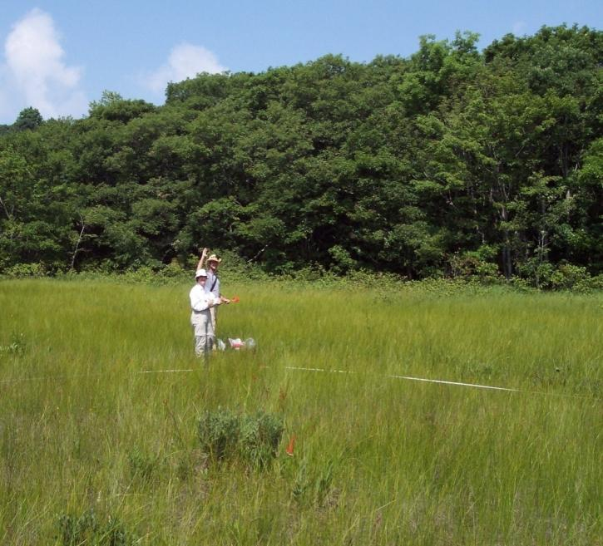
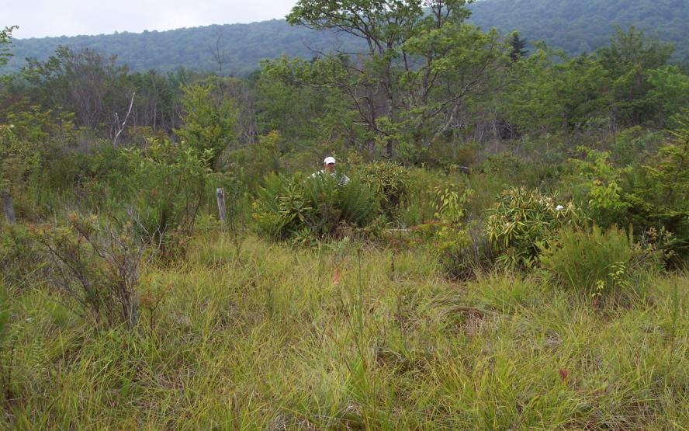
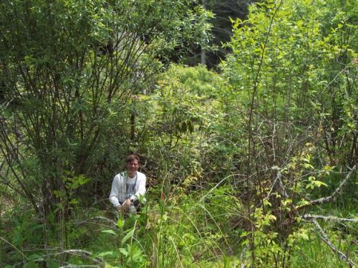
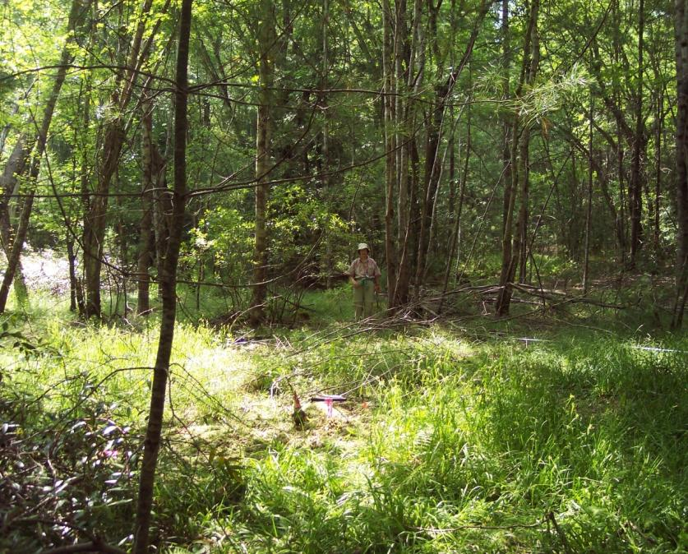
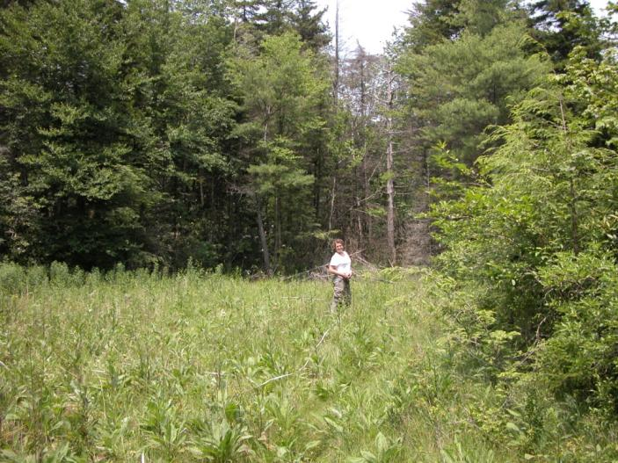
Vegetation
Montane non-alluvial wetlands
shrub bogs
mosaics bogs
mafic fens
forested bogs
herbaceous bogs

Slide 37
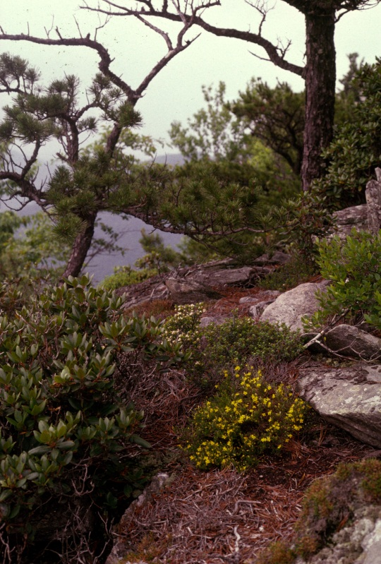
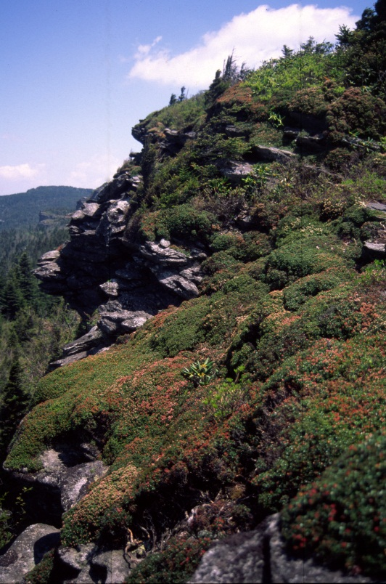
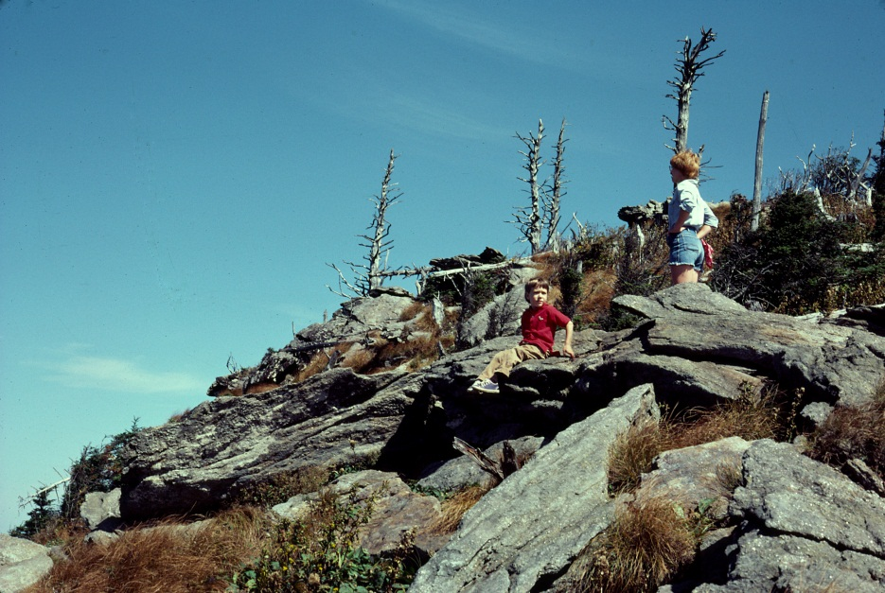
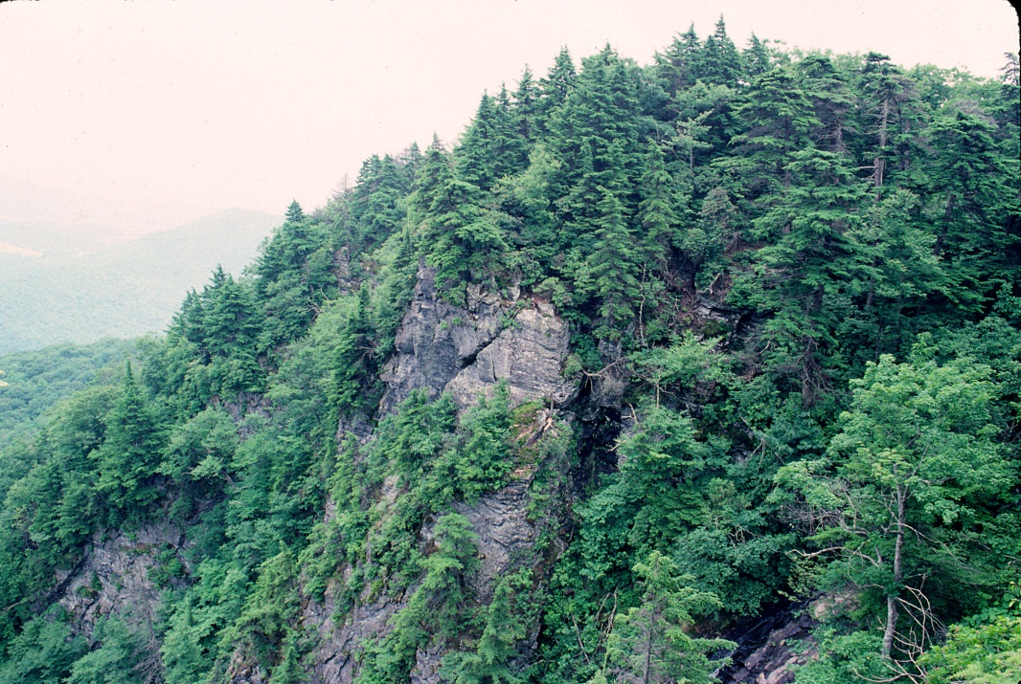

High-elevation rock outcrops

Slide 38

Appalachian Forests

Slide 39



Whittaker’s Model

Slide 40






Slide 41


Highest species richness in CVS database
Area | Spp | Community
1000 m² | 175 | Alnus serrulata - Xanthorhiza simplicissima Shrubland
100 m² | 129 | Alnus serrulata - Xanthorhiza simplicissima Shrubland
10 m² | 72 | Pinus palustris / Arundinaria gigantea - Liquidambar styraciflua / Andropogon glomeratus - Sarracenia minor Woodland
1.0 m² | 52 | Pinus palustris - Pinus serotina / Sporobolus pinetorum - Aristida stricta - Eryngium integrifolium Woodland
0.1 m² | 35 | Pinus palustris - Pinus serotina / Sporobolus pinetorum - Aristida stricta - Eryngium integrifolium Woodland

Slide 42


Long-term Change
Coastal Plain Rivers
23,000,000,000 ft²

Slide 43


Long-term Change:
Piedmont forest

Slide 44

Piedmont Forests
What is going on?
Loss of fire ?
Exotics ?
Climate change?
Deer browse ?

Slide 45


Frequently burned Piedmont woodland

Slide 46



Invasive species in the Duke Forest
(Fertile sites; scales differ)
Microstegium Lonicera Others

Slide 47


Sho
Piedmont riparian vegetation

Slide 48
Better, cheaper, more defendable restoration targets
Level 1 – Web tool for
documenting reference
conditions by NVC types.
Level 2 – Web tool for predicting a target from site conditions.

Slide 49

Database tool predicts target vegetation type based on site data.

Slide 50
Restoration targets
EEP contractors can use CVS plot data to establish site-specific restoration targets.
Cheaper and better than the traditional approach.
Growers can better predict material needs.
EEP can better evaluate plans and anticipate significantly higher success.

Slide 51











We are pleased to acknowledge the support and cooperation of
Gap Analysis Program

