Slide 1
An expert system for generating restoration targets for Carolina Piedmont riparian vegetation
Elizabeth R. Matthews, Michael Lee, M. Forbes Boyle, and Robert K. Peet
University of North Carolina, Chapel-Hill

Slide 2
CVS-EEP restoration protocol
Exploit a broad array of reference plots
Derive site-specific restoration targets
CVS plot and NVC data
Design site-specific restoration plan
Implement the plan
Monitor change and assess success
Employ adaptive management along the way

Slide 3
CVS-EEP restoration protocol
Exploit a broad array of reference plots
Derive site-specific restoration targets
CVS plot and NVC data
Design site-specific restoration plan
Implement the plan
Monitor change and assess success
Employ adaptive management along the way

Slide 4
Quantitative vegetation descriptions → restoration targets
Quantitative vegetation descriptions
Carolina Vegetation Survey http://cvs.bio.unc.edu/
U.S. National Vegetation Classification http://www.natureserve.org/explorer/
Match vegetation descriptions to restoration sites
Cost-effective
Improvement on traditional approaches

Slide 5
Classification and description of vegetation types
Critical environmental fields defined
How to do this?
Restoration sites identified and environmental data collected
Restoration sites matched to described vegetation types
Planting lists generated from vegetation type descriptions

Slide 6
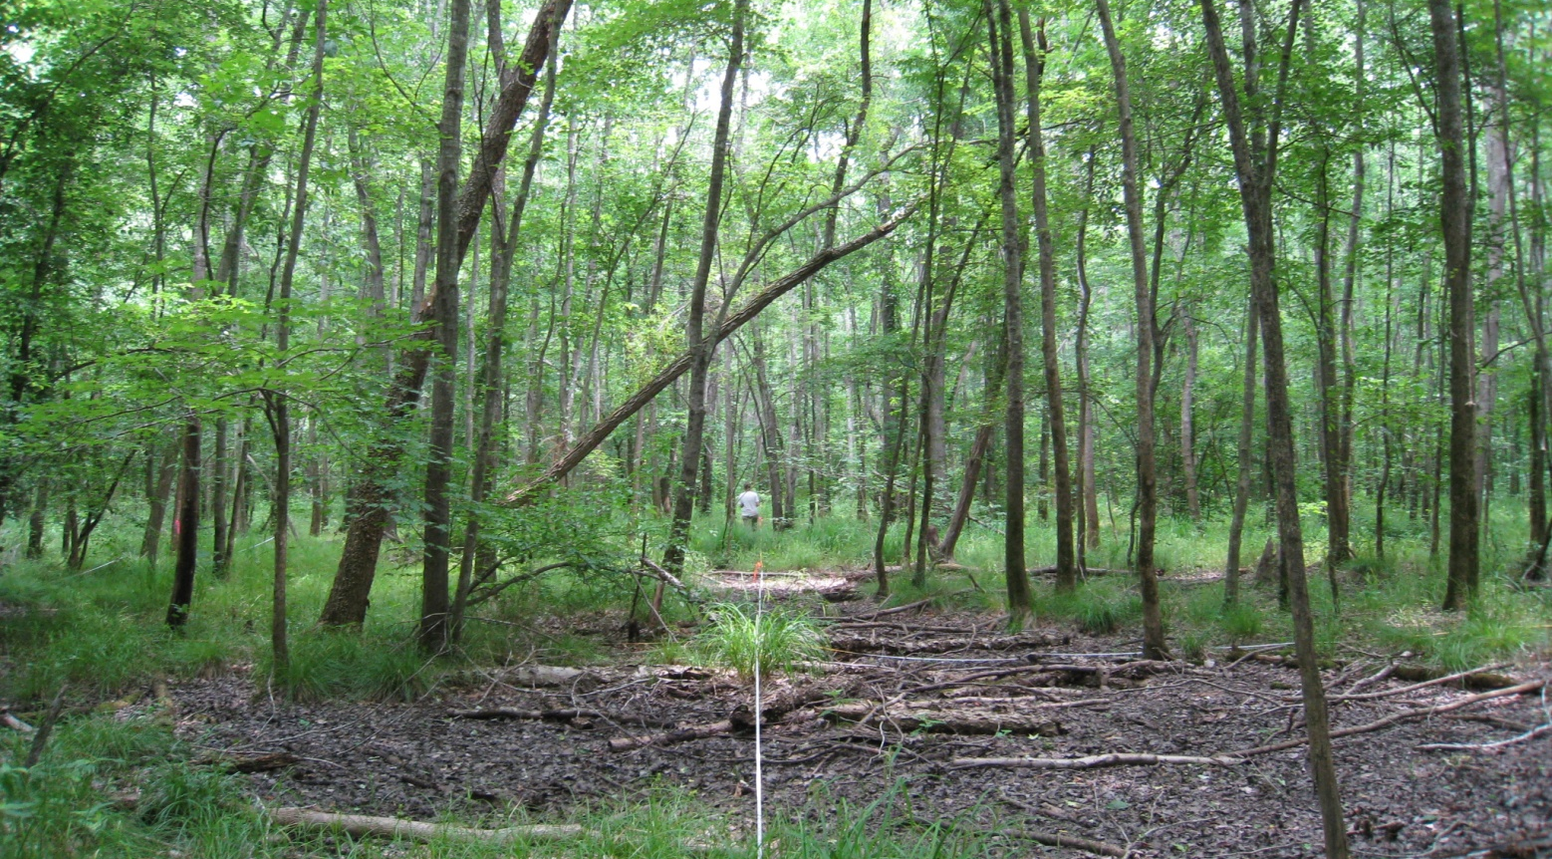
Case study: Piedmont alluvial vegetation
Quantitative classification of NC alluvial vegetation
North Carolina Ecosystem Enhancement Program restoration sites

Slide 7
Classification and description of vegetation types
Critical environmental fields defined
How to do this?
Restoration sites identified and environmental data collected
Restoration sites matched to described vegetation types
Planting lists generated from vegetation type descriptions

Slide 8
Classification and description of vegetation types
Collect reference site field data
Classify communities using standard quantitative techniques
Cluster analysis; discriminant analyses; ordination

Slide 9
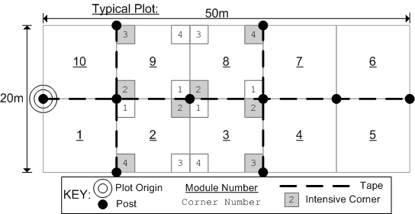
Vegetation Type Descriptions: field data
Carolina Vegetation Survey (CVS) protocol 20m × 50m plots (Peet et al 1998)
Cover by strata
Soil samples, environmental data, and geomorphology

Slide 10
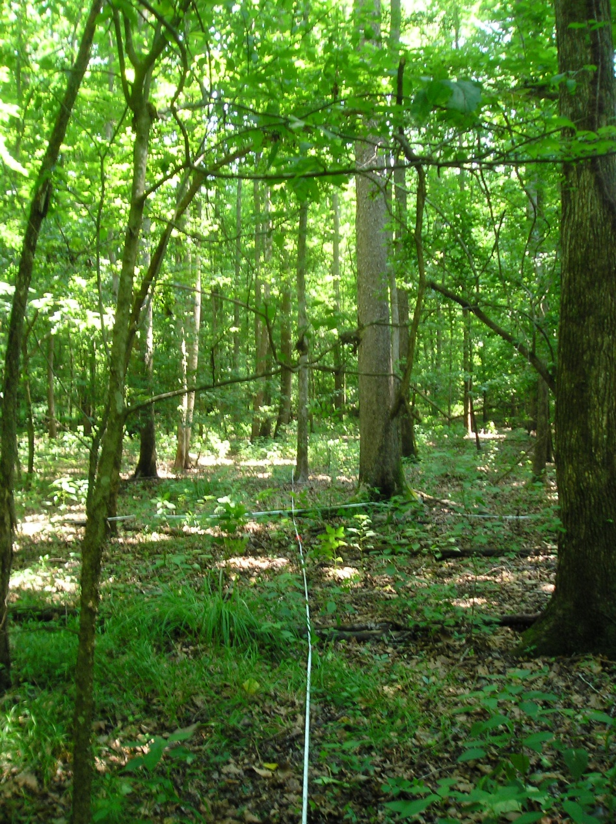
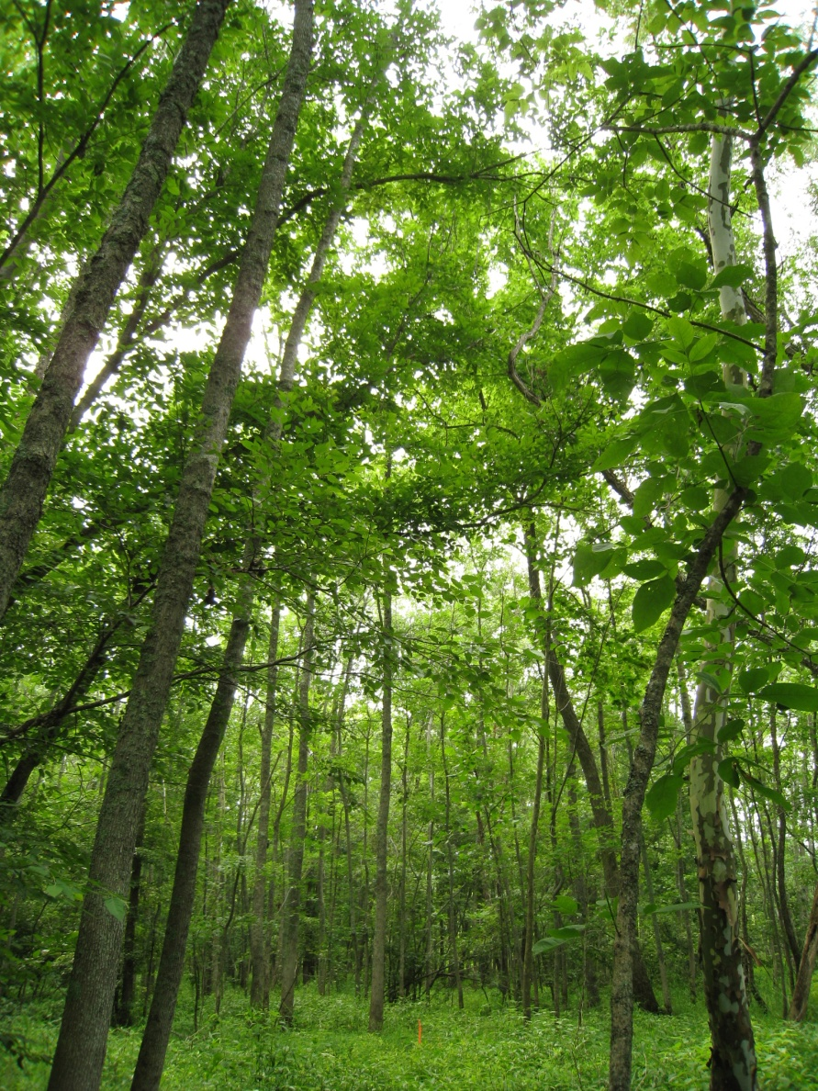
Vegetation Type Descriptions: field data

Slide 11
Vegetation Type Descriptions: field data

Slide 12
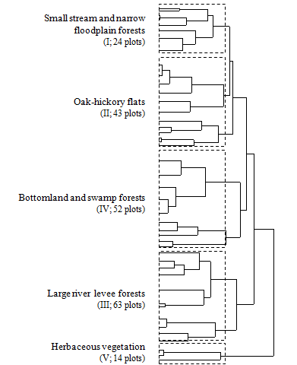
Flexible beta, β = -0.25
Cover by strata
2-tier, hierarchical classification
5 higher-level groups recognized
14 vegetation types recognized

Slide 13
Quantitative Vegetation Descriptions
•
*
Small streams
Oak-hickory flats
Large river levees
Bottomlands and
swamp forests

Slide 14
Quantitative Vegetation Descriptions

Slide 15
Classification as a guide to NVC revision
ID | N | Alluvial vegetation type |  | NVC community type (with CEGL code)
I. Small streams and narrow floodplain forests
Ia. | 18 | Liriodendron tulipifera – Liquidambar styraciflua / Lindera benzoin/ Amphicarpaea bracteata Forest | >< | 4418 | Liquidambar styraciflua - Liriodendron tulipifera / Lindera benzoin / Arisaema triphyllum Forest
Ia. |  |  | >< | 7329 | Liquidambar styraciflua - Liriodendron tulipifera / Onoclea sensibilis Forest
Ia. |  |  | > | 7321 | Fagus grandifolia - Acer barbatum / Asimina triloba / Toxicodendron radicans / Carex blanda Forest
Ib. | 6 | Liriodendron tulipifera - Betula nigra / Cornus florida / Sanicula canadensis var. canadensis Forest | < | 4418 | Liquidambar styraciflua - Liriodendron tulipifera / Lindera benzoin / Arisaema triphyllum Forest
II. Oak-hickory flats
IIa. | 32 | Liquidambar styraciflua - Quercus nigra / Carpinus caroliniana / Mitchella repens Forest | >< | 4419 | Liriodendron tulipifera / Asimina triloba / Arundinaria gigantea ssp. gigantea Forest
IIa. |  |  | >< | 7329 | Liquidambar styraciflua - Liriodendron tulipifera / Onoclea sensibilis Forest
IIb. | 3 | Liquidambar styraciflua- Quercus pagoda- Carya cordiformis/ Asimina triloba/ Arundinaria tecta Forest | >< | 4419 | Liriodendron tulipifera / Asimina triloba / Arundinaria gigantea ssp. gigantea Forest
IIc. | 8 | Carya carolinae-septentrionalis - Acer floridanum / Aesculus sylvatica/ Zizia aurea Forest | >< | 8487 | Quercus shumardii - Quercus michauxii - Quercus nigra / Acer barbatum - Tilia americana var. heterophylla Forest
IIc. |  |  | >< | 7356 | Quercus pagoda - Quercus phellos - Quercus lyrata - Quercus michauxii / Chasmanthium latifolium Forest

Slide 16
ID | N | Alluvial vegetation type |  |  | NVC community type (with CEGL code)
I. Small streams and narrow floodplain forests
Ia. | 18 | Liriodendron tulipifera – Liquidambar styraciflua / Lindera benzoin/ Amphicarpaea bracteata Forest | >< | 4418 |  | Liquidambar styraciflua - Liriodendron tulipifera / Lindera benzoin / Arisaema triphyllum Forest
Ia. |  |  | >< | 7329 |  | Liquidambar styraciflua - Liriodendron tulipifera / Onoclea sensibilis Forest
Ia. |  |  | > | 7321 |  | Fagus grandifolia - Acer barbatum / Asimina triloba / Toxicodendron radicans / Carex blanda Forest
Ib. | 6 | Liriodendron tulipifera - Betula nigra / Cornus florida / Sanicula canadensis var. canadensis Forest | < | 4418 |  | Liquidambar styraciflua - Liriodendron tulipifera / Lindera benzoin / Arisaema triphyllum Forest
II. Oak-hickory flats
IIa. | 32 | Liquidambar styraciflua - Quercus nigra / Carpinus caroliniana / Mitchella repens Forest | >< | 4419 |  | Liriodendron tulipifera / Asimina triloba / Arundinaria gigantea ssp. gigantea Forest
IIa. |  |  | >< | 7329 |  | Liquidambar styraciflua - Liriodendron tulipifera / Onoclea sensibilis Forest
IIb. | 3 | Liquidambar styraciflua- Quercus pagoda- Carya cordiformis/ Asimina triloba/ Arundinaria tecta Forest | >< | 4419 |  | Liriodendron tulipifera / Asimina triloba / Arundinaria gigantea ssp. gigantea Forest
IIc. | 8 | Carya carolinae-septentrionalis - Acer floridanum / Aesculus sylvatica/ Zizia aurea Forest | >< | 8487 |  | Quercus shumardii - Quercus michauxii - Quercus nigra / Acer barbatum - Tilia americana var. heterophylla Forest
IIc. |  |  | >< | 7356 |  | Quercus pagoda - Quercus phellos - Quercus lyrata - Quercus michauxii / Chasmanthium latifolium Forest
III. Large river levee forests
IIIa. | 33 | Ulmus americana - Celtis laevigata/ Lindera benzoin / Osmorhiza longistylis Levee Forest | > | 7730 |  | Platanus occidentalis - Celtis laevigata - Fraxinus pennsylvanica / Lindera benzoin - Ilex decidua / Carex retroflexa Forest
IIIa. |  |  | >< | 7340 |  | Platanus occidentalis - Liquidambar styraciflua / Carpinus caroliniana - Asimina triloba Forest
IIIa. |  |  | >< | 4419 |  | Liriodendron tulipifera / Asimina triloba / Arundinaria gigantea ssp. gigantea Forest
IIIb. | 30 | Fraxinus pennsylvanica- Platanus occidentalis / Acer negundo/ Chasmanthium latifolium Levee Forest | ~ | 7340 |  | Platanus occidentalis - Liquidambar styraciflua / Carpinus caroliniana - Asimina triloba Forest

Slide 17
Classification and description of vegetation types
Critical environmental fields defined
How to do this?
Restoration sites identified and environmental data collected
Restoration sites matched to described vegetation types
Planting lists generated from vegetation type descriptions

Slide 18
Identify critical environmental variables
Classification methods
Random Forests
Preliminary list of environmental predictors established via:
past field work
expert knowledge
published literature
reference classifications
Easily obtainable, GIS-derived environmental variables
Add graphic related to literature evironment or gis

Slide 19
Classification methods, particularly Random Forests, great at identifying and ranking important variables

Slide 20
Classification and description of vegetation types
Critical environmental fields defined
How to do this?
Restoration sites identified and environmental data collected
Restoration sites matched to described vegetation types
Planting lists generated from vegetation type descriptions

Slide 21
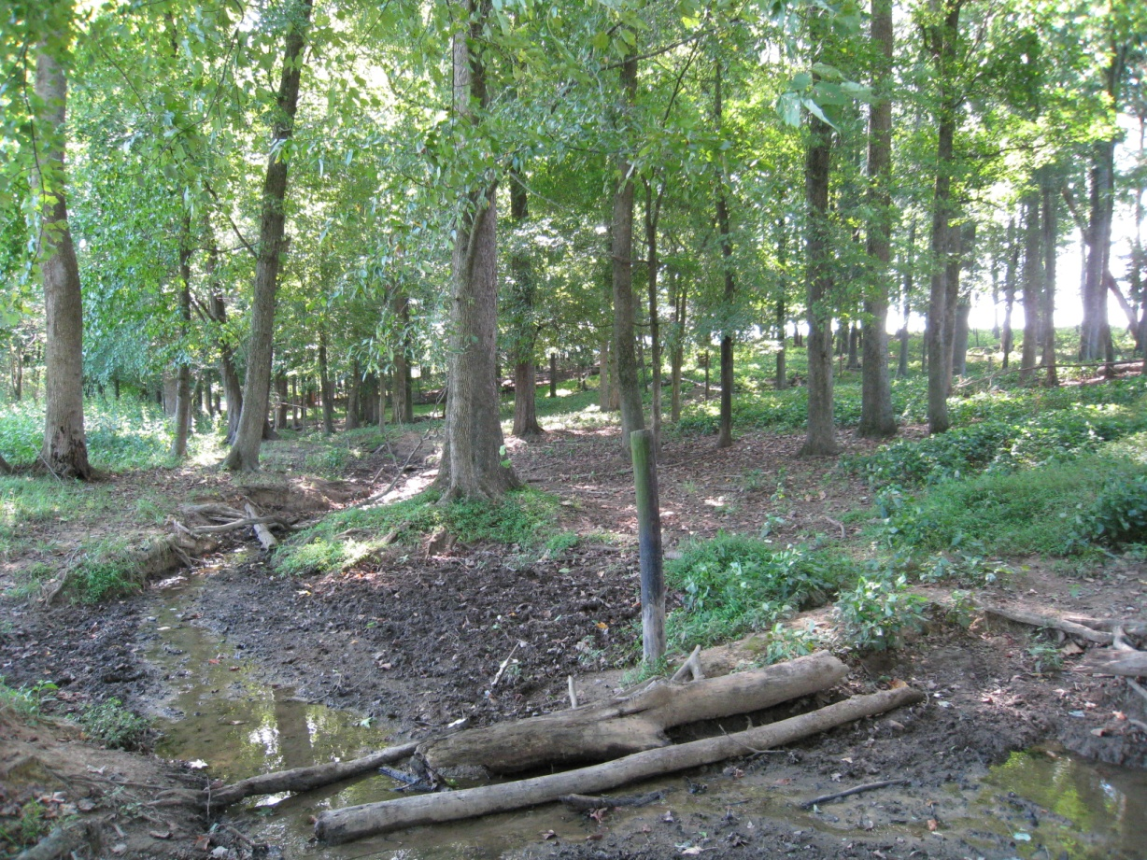
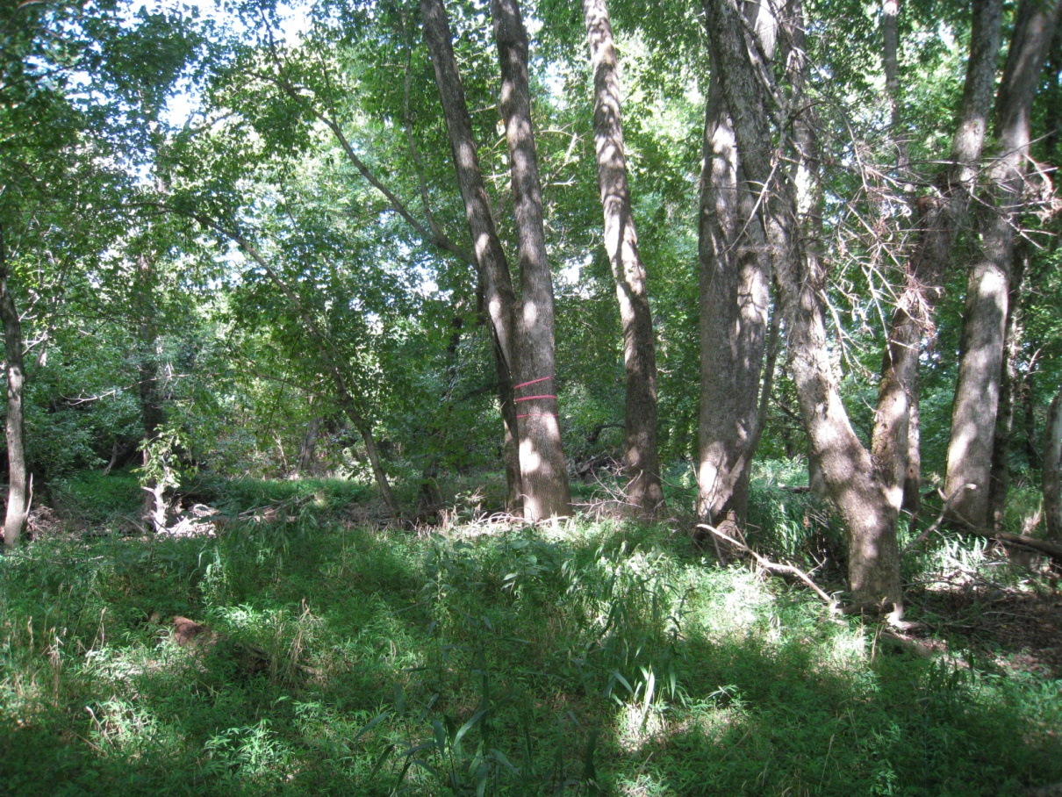
Wells Creek,
XXX County
Mason Farm,
Orange County

Slide 22
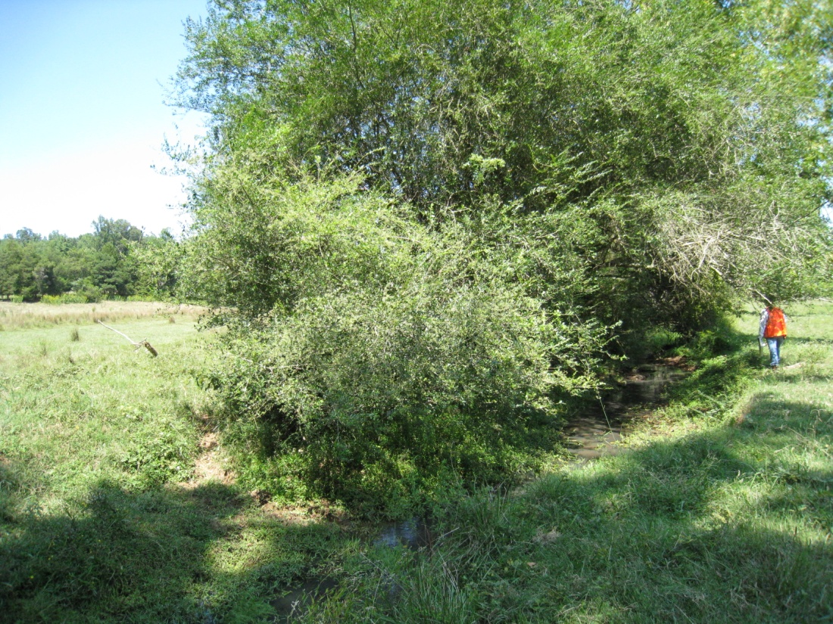
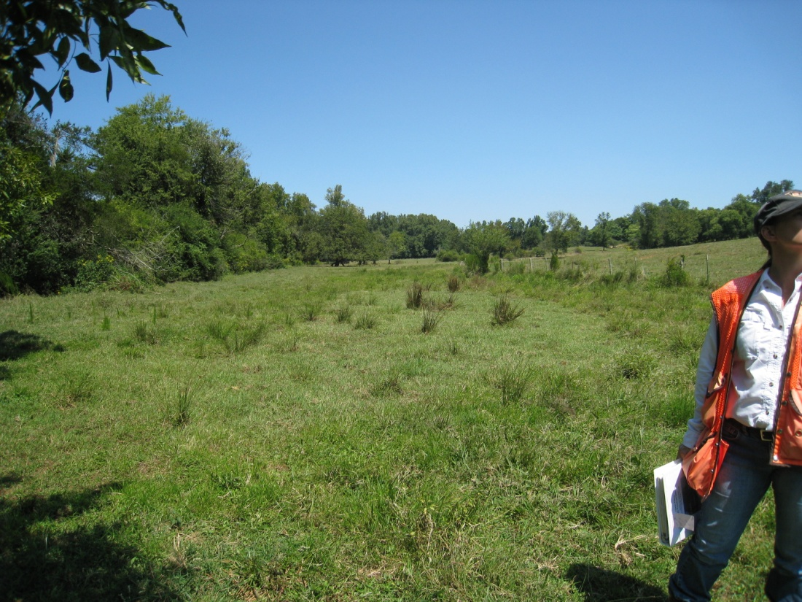
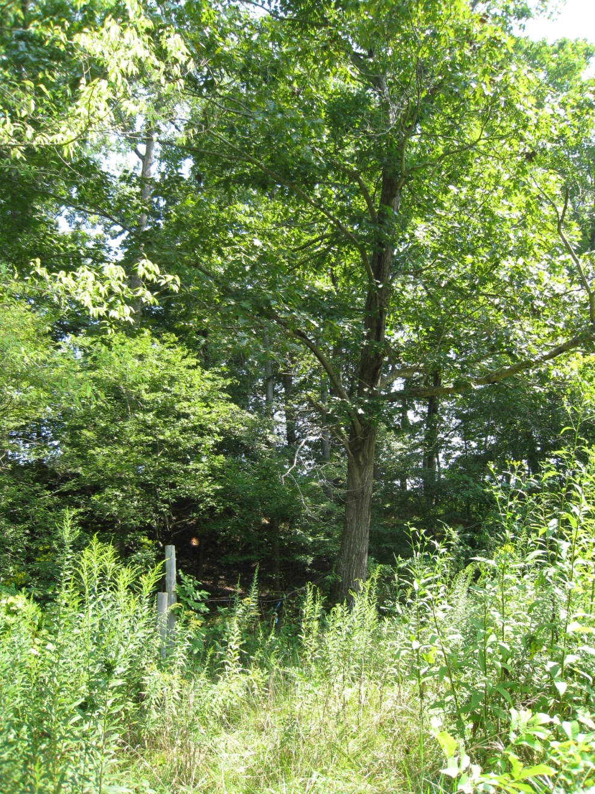
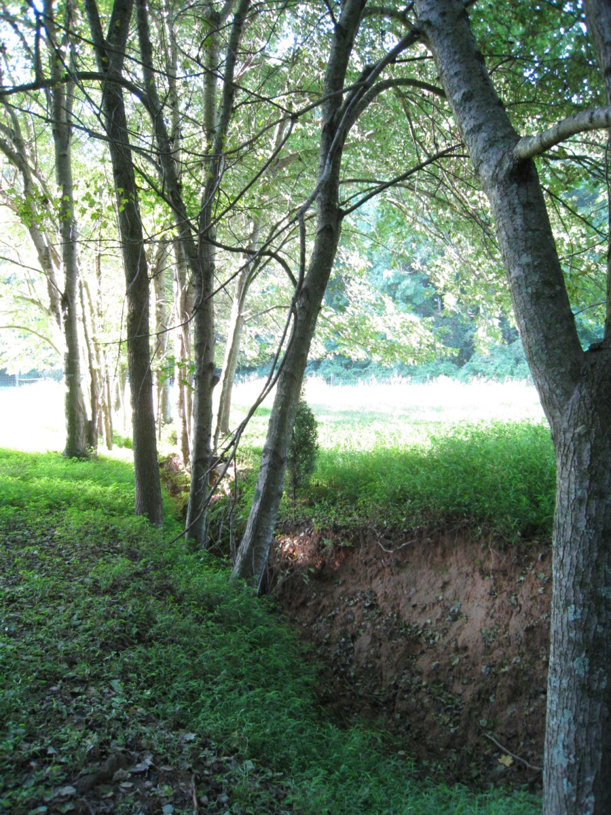
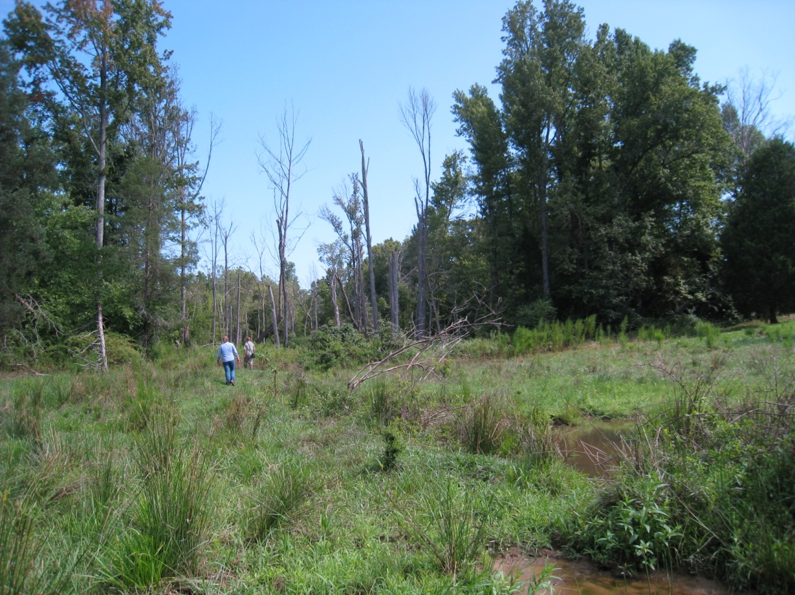
Sandy Creek,
XXX County
Mill Creek,
XXX County
UT to West Fork Deep,
XXX County
UT to Haw,
XXX County

Slide 23
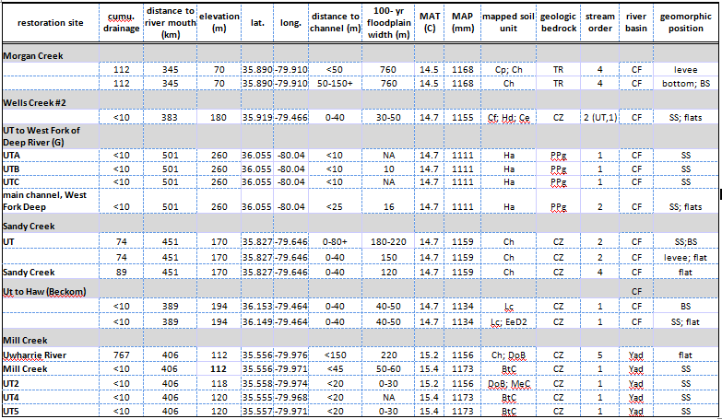
Collected environmental data (field and GIS) at each site

Slide 24
Classification and description of vegetation types
Critical environmental fields defined
How to do this?
Restoration sites identified and environmental data collected
Restoration sites matched to described vegetation types
Planting lists generated from vegetation type descriptions

Slide 25
Quantitative matching
Bray-Curtis dissimilarity metric (Bray & Curtis 1957), defined as,
where N_{i} = i ^{th} environmental variable at the new site, G_{i} = group average for i ^{th} environmental variable, w_{i} = weight for i^{th} environmental variable.

Slide 27
Classification and description of vegetation types
Critical environmental fields defined
How to do this?
Restoration sites identified and environmental data collected
Restoration sites matched to described vegetation types
Planting lists generated from vegetation type descriptions

Slide 30
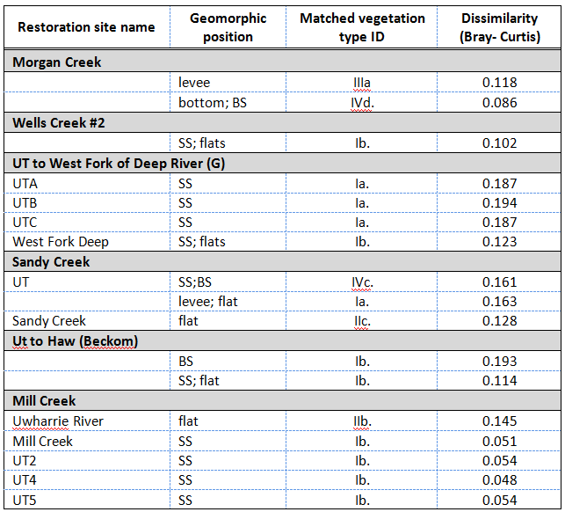

Slide 32
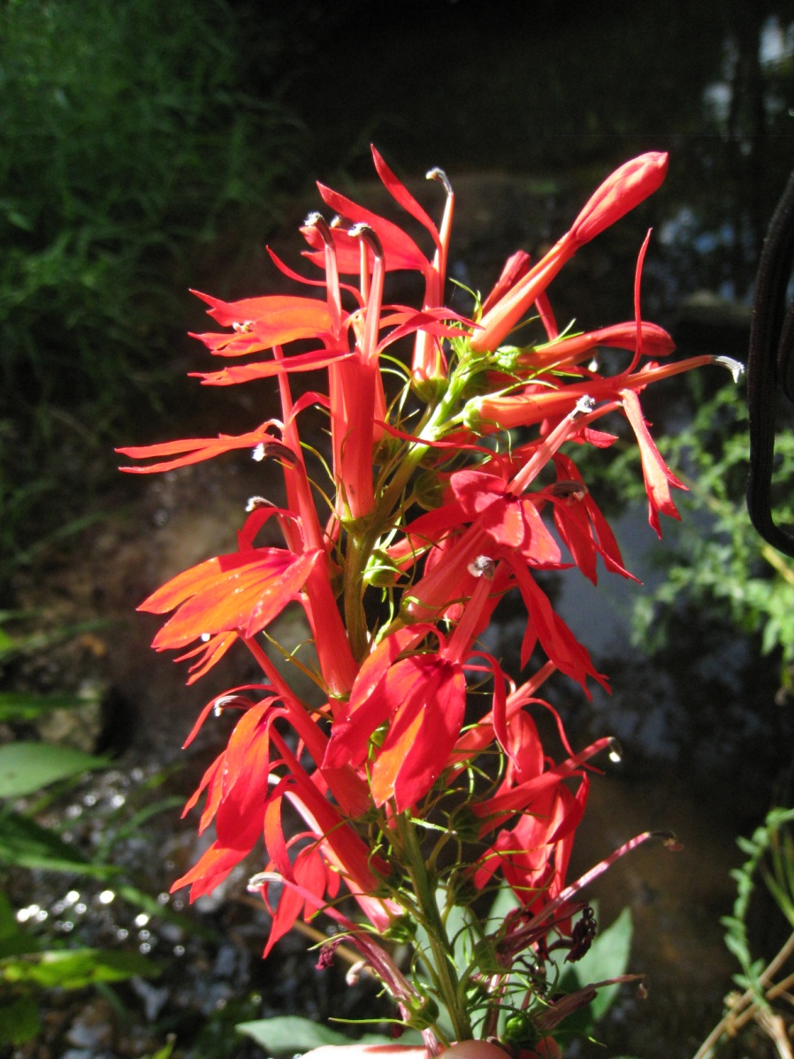
Planting lists
Planting lists may be edited from type-descriptions
dispersal-limited
rare species
types with high cover/constancy of early-successional species

Slide 33
Future directions
Broader implementation– other systems, other classifications
Fine-tuning of the tool
Feedback!
Download the tool at:

Slide 34
Thanks
Support for this project came from the NC Ecosystem Enhancement Program, North Carolina Beautiful, and the Society of Wetland Scientists
Forbes Boyle, Brenda Wichmann, Jessi Outzs, Jose Zúñiga, Megan Faestel, Brucie Sorrie, Richard LeBlond, Mike Schafale, and the Plant Ecology Lab at UNC

Slide 35
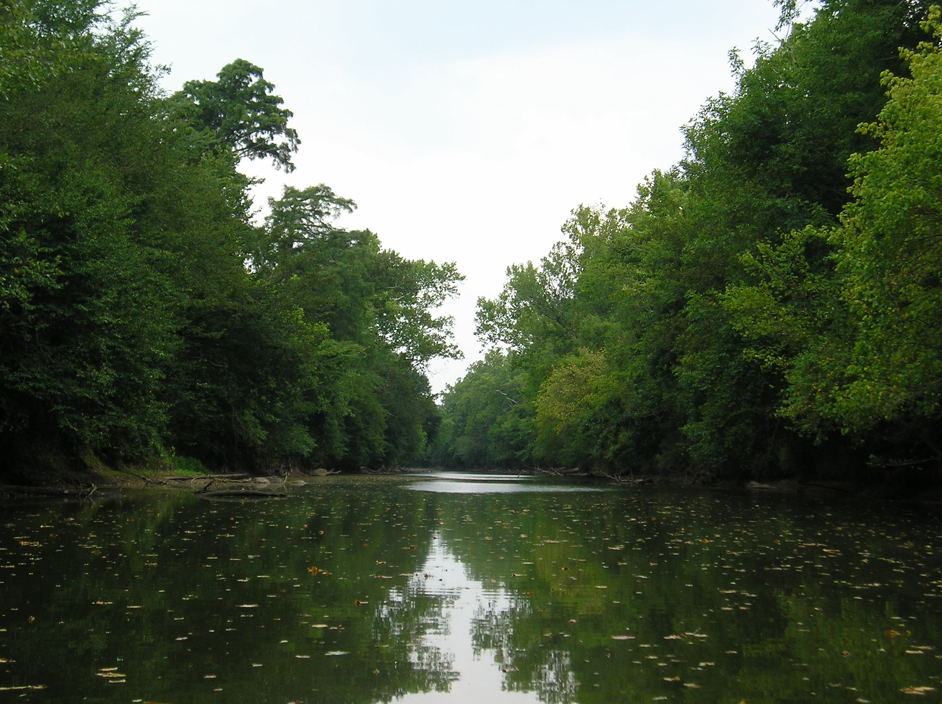
Questions?

